Slide 1
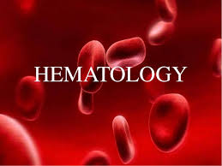
MRS RACHAEL

Slide 2
INTRODUCTION
The word hematology comes from the Greek haima(means blood) and logos (means discourse); therefore, the study of hematology is the science, or study, of blood. Hematology encompasses the study of blood cells and coagulation.

Slide 3
INTRODUCTION CONT’D
Included in its concerns are analyses of the
concentration, structure, and function of cells in blood; their precursors in the bone marrow; chemical constituents of plasma or serum intimately linked with blood cell structure and function; and function of platelets and proteins involved in blood coagulation.

Slide 4
THE BLOOD
Composition blood
Blood is a circulating tissue composed of fluid plasma and cells.
It is composed of different kinds of cells (occasionally called corpuscles); these formed elements of the blood constitute about 45% of whole blood.
The other 55% is blood plasma, a fluid that is the blood's liquid medium, appearing yellow in color. The normal Ph of human arterial blood is approximately 7.40 (normal range is 7.35-7.45), a weak alkaline solution.

Slide 5
Blood is about 7% of the human body weight, so the average adult has a blood volume of about 5 liters, of which 2.7-3liters is plasma.
The combined surface area of all the red cells in the human body would be roughly 2000times as great as the body's exterior surface.

Slide 6
Blood plasma
When the formed elements are removed from blood, a straw-colored liquid called plasma is left.
Plasma is about 91.5% water and 8.5% solutes, most of which by weight (7%) are proteins.
Some of the proteins in plasma are also found elsewhere in the body, but those confined to blood are called plasma proteins.

Slide 7
These proteins play a role in maintaining proper blood osmotic pressure, which is important in total body fluid balance.
Most plasma proteins are synthesized by the liver, including the albumins (54% of plasma proteins), globulins (38%), and fibrinogen (7%).
Other solutes in plasma include waste products, such as urea, uric acid, creatinine, ammonia, and bilirubin; nutrients; vitamins; regulatory substances such as enzymes and hormones; gasses; and electrolytes.

Slide 8
Formed elements
The formed elements of the blood are broadly classified as:
red blood cells (erythrocytes),
white blood cells (leucocytes)
platelets (thrombocytes) and their numbers remain remarkably constant for each individual in health.

Slide 9
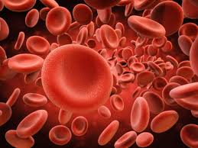
RED BLOOD CELL

Slide 10
Red Blood Cells
They are the most numerous cells in the blood. In adults, they are formed in the marrow of the bones that form the axial skeleton.
Mature red cells are non - nucleated and are shaped like flattened, bilaterally indented spheres, a shape often referred to as ”biconcave disc” with a diameter 7.0-8.0μm and thickness of 1.7-2.4μm.

Slide 11
They are primarily involved in tissue respiration.
The red cells contain the pigment hemoglobin which has the ability to combine reversibly with 02.
In the lungs, the hemoglobin in the red cell combines with 02 and releases it to the tissues of the body (where oxygen tension is low) during its circulation

Slide 12
Carbondioxide, awaste product of metabolism, is then absorbed from the tissues by the red cells and is transported to the lungs to be exhaled.
The red cell normally survives in the blood stream for approximately 120 days after which time it is removed by the phagocytic cell s of the reticuloendothelial system, broken down and some of its constituents are utilized for the formation of new cells

Slide 13
White Blood Cells
They are a heterogeneous group of nucleated cells that are responsible for the body’s defenses and are transported by the blood to the various tissues where they exert their physiologic role, e.g. phagocytosis.

Slide 14
WBCs are present in normal blood in smaller number than the red blood cells (5.0-10.0 × 103/μl in adults). Their production is in the bone marrow and lymphoid tissues (lymph nodes, lymph nodules and spleen).

Slide 15
There are five distinct cell types each with characteristic morphologic appearance and specific physiologic role.
These are:
Polymorphonuclear leucocytes/granulocytes
Neutrophils
Eosinophils
Basophiles
Mononuclear leucocytes
Lymphocytes
Monocytes

Slide 16
(a) Polymorphonuclear Leucocytes
Polymorphonuclear Leucocytes have a single nucleus with a number of lobes.
They Contain small granules in their cytoplasm, and hence the name granulocytes.
There are three types according to their staining reactions.

Slide 17
Neutrophils
Their size ranges from 10-12μm in diameter. They are capable of amoeboid movement. There are 2-5 lobes to their nucleus that stain purple violet.
The cytoplasm stains light pink with pinkish dust like granules.
Their number increases in acute bacterial infections.

Slide 18
Eosinophils
Eosinophils have the same size as neutrophils or may be a bit larger (12-14μm).
There are two lobes to their nucleus in a "spectacle" arrangement. Their nucleus stains a little paler than that of neutrophils.

Slide 19
Eosinophils
cytoplasm contains many, large, round/oval orange pink granules.
They are involved in allergic reactions and in combating helminthic infections.
Normal range: 40-400/μl. Increase in their number (eosinophilia) is associated with allergic reactions and helminthiasis.

Slide 20
Basophils
Their size ranges from 10-12μm in diameter.
Basophiles have a kidney shaped nucleus frequently obscured by a mass of large deep purple/blue staining granules.
Their toplasmic granules contain heparin and histamine that are released at the site of inflammation. Normal range: 20-200/μl. Basophilia is rare except in cases of chronic myeloid leukemia.

Slide 21
(b) Mononuclear Leucocytes
Lymphocytes
Have a large nuclei
 Functionally divided into two
1. T-Lymphocytes – activated in thymus gland
2. B-Lymphocytes- activated in bone marrow
Lymphocytes circulate in blood but are present in large
numbers in lymphatic tissue
e.g. - Lymph nodes
- Spleen

Slide 22
After activation, the lymphocytes become immunocompetent
– are able to respond to antigens (foreign
Material

Slide 23
Examples of antigens
1. Pollen from flowers & plants
2. Fungi
3. Bacteria
4. Large molecule drugs – penicillin, aspirin
5. Cell regarded by lymphocytes as abnormal
- cancer cells
- virus invaded cells
- Tissue transplant cells

Slide 24
T-Lymphocytes are activated by thymosin in the thymus gland
B-Lymphocytes are activated in the red BM & in the lymphoid tissue such as walls of intestines
Some cells of both types circulate in the blood, Some settle in lymphoid tissue:
- Lymph nodes
- the spleen
- glands in the walls of the upper respiratory tract & the intestines

Slide 25
Monocytes
Monocytes are the largest white cells measuring 14-18μm in diameter.
They have a centrally placed, large and ‘horseshoe’ shaped nucleus that stains pale violet. Their cytoplasm stains pale grayish blue and contains reddish blue dust-like granules and a few clear vacuoles.
.

Slide 26
Platelets
These are small, non nucleated, round/oval cells/cell
fragments that stain pale blue and contain many pink granules.
Their size ranges 1-4μm in diameter.
They are produced in the bone marrow by fragmentation of cells called megakaryocytes which are large and multinucleated cells.

Slide 27
They are capable of ingesting bacteria and particulate matter and act as "scavenger cells" at the site of infection. Normal range: 700-1500/μl.
Monocytosis is seen in bacterial infections. (e.g.tuberculosis) and protozoan infections

Slide 28
When activated cells encounter antigens,
Each type divides into two groups:
1. Effector cells – promote destruction of antigens
2. Memory cells – remain in lymphoid tissue &
multiply

Slide 29
Function of memory cells
1. Pass on specific protective capabilities to subsequent generation of cells
2. Confer immunity – subsequent encounter with the same antigen leads to proliferation of more sensitized lymphocytes

Slide 30
Response of activated lymphocytes
to specific antigens
1. Produce cell-mediated immunity – mediated by T –Lymphocytes & specialised T-cells that combat cells
containing antigens
2. Produce Humoral immunity – mediated by B Lymphocytes which involves the production of
antibodies that neutralize antigens directly

Slide 31
ANEMIAS
Anemia is a condition in which the amount of
hemoglobin in a patient’s circulatory system is reduced.
A physiologic definition stresses the inability of ananemic individual to maintain normal tissue oxygenation.
This may result form decreased hemoglobin content or reduced red cell number

Slide 32
Reduction in plasma volume (as in dehydration) may mask anemia or even cause
polycythemia;
conversely, an increase in plasma volume (as with splenomegaly or pregnancy) may cause anemia even with a normal total circulating red cell and hemoglobin mass

Slide 33
Etiologic classification of Anemia
1. Loss of blood:
Acute post hemorragic anemia
Chronic post hemorrhagic anemia
2. Excessive destruction of RBC:
a) Extra corpuscular causes: Antibodies Infection(malaria),
• Splenic sequestration and destruction
• Drugs, chemicals and physical agents

Slide 34
b) Intracorpuscular haemolytic disease
1) Hereditary
• Disorder of glycolysis, abnormalities in RBC membrane.
• Abnormalities in synthesis of globin
2) Acquired – lead poisonong

Slide 35
Classification of anemia cont’d
3. Impaired blood production resulting from deficiency of substances essential for erythropoiesis
a. Iron deficiency
b. Deficiency of vitamin B12 , folic acid and Protein deficiency.

Slide 36
Classification of anemia cont’d
4.Inadequate production of mature erythrocytes
a) Deficiency of erythroblasts
b) Pure red cell aplasia
c) Infiltration of bone marrow- Leukemia, lymphoma, Multiple myeloma
d) Endocrine abnormality- myxedema
e) Chronic renal disease
f) Chronic inflammatory disease
g) Cirrohisis of liver

Slide 37
Classification of anemia cont’d
Normocytic - occurs when the overall hemoglobin levels are decreased, but the red blood cell size (mean corpuscular volume) remains normal. Causes include: Acute blood loss,Anemia of chronic disease
Microcytic- result of hemoglobin synthesis
failure/insufficiency. Iron deficiency anemia, thalassemia.

Slide 38
Macrocytic- Megaloblastic anemia, the most common cause of macrocytic anemia, is due to a deficiency of either vitamin B12, folic acid, or both. Also seen in hypothyroidism,alcoholism.
Hypochromic microcytic- iron deficiency anemia.

Slide 39
BLOOD CELL DISORDERS
Erythrocytoses
Polycythemia vera
Anemia
Iron deficiency anemia
Anemia owing to hemolysis
Sickle cell anemia
Pernicious anemia
Aplastic anemia
Erythroblastosis fetalis
Thalassemia
Agranulocytosis
Hypoprothrombinemia
Haemophilia
Disseminated intravascular coagulation

Slide 40
Types of anemia
1. Sickle cell disease
Sickle cell anemia is an inherited form of anemia — a condition in which there aren't enough healthy red blood cells to carry adequate oxygen throughout your body.
Normally, your red blood cells are flexible and round, moving easily through your blood vessels. In sickle cell anemia, the red blood cells become rigid and sticky and are shaped like sickles or crescent moons. These irregularly shaped cells can get stuck in small blood vessels, which can slow or block blood flow and oxygen to parts of the body.

Slide 41
The Role of Haemoglobin
Haemoglobin is an essential cellular component of the red blood cells that play the role of transporting oxygen in the blood to the bodily tissues where it is required.
Sickle haemoglobin differs in physical shape from the normal haemoglobin, with a curved sickle-shaped rather than flat-disc shaped cells. The shape alters the properties of the cells, causing then to become more rigid and less flexible. As a result of this, the cells are more likely to hemolyse and cause blockages in the blood vessels that disrupt the flow of blood.

Slide 42
Genetic Mutation
The specific gene mutation that results in sickle haemoglobin involves a substitution of thymine for adenine (from GAG to GTG) on the sixth codon of the genetic sequence.
This leads to the coding of valine rather than glutamate on the sixth position of the haemoglobin beta chain

Slide 43
This genetic alteration changes the physical properties of the haemoglobin cells, changing their shape to the characteristic sickle shape and the physical properties, such as solubility and stability.
It is these properties that account for changes in function and the common complications of the disease

Slide 44
Sickle Cell: Pathophysiology
Deoxygenation of mutant Hb leads to
↑ K⁺ efflux
↑ cell density / dehydration
↑ polymerization
Sickled cells adhere to endothelial cells
Endothelial factors ↑ vasoconstriction
Blood flow ↓ promotes vaso-occlusion
“Vicious cycle” with decreased blood flow, hypoxemia / acidosis, increased sickling
Some cells become irreversibly sickled

Slide 45
FACTORS THAT INCREASE Hgb S POLYMERIZATION
Decreased oxygen
Increased intracellular hemoglobin S concentration (SS > SC, S-thal)
Increased 2,3-DPG
Decreased pH
Slowed transit time through the circulation
Endothelial adhesion

Slide 46
Symptoms
Signs and symptoms of sickle cell anemia, which vary from person to person and change over time, include:
Anemia. Sickle cells break apart easily and die, leaving you without enough red blood cells. Red blood cells usually live for about 120 days before they need to be replaced. But sickle cells usually die in 10 to 20 days, leaving a shortage of red blood cells (anemia).
Without enough red blood cells, your body can't get the oxygen it needs to feel energized, causing fatigue.

Slide 47
Episodes of pain. Periodic episodes of pain, called crises, are a major symptom of sickle cell anemia. Pain develops when sickle-shaped red blood cells block blood flow through tiny blood vessels to your chest, abdomen and joints. Pain can also occur in your bones.
The pain varies in intensity and can last for a few hours to a few weeks. Some people have only a few pain episodes. Others have a dozen or more crises a year. If a crisis is severe enough, you might need to be hospitalized
Some adolescents and adults with sickle cell anemia also have chronic pain, which can result from bone and joint damage, ulcers and other causes.

Slide 48
Painful swelling of hands and feet. The swelling is caused by sickle-shaped red blood cells blocking blood flow to the hands and feet.
Frequent infections. Sickle cells can damage an organ that fights infection (spleen), leaving you more vulnerable to infections. Doctors commonly give infants and children with sickle cell anemia vaccinations and antibiotics to prevent potentially life-threatening infections, such as pneumonia.

Slide 49
Delayed growth. Red blood cells provide your body with the oxygen and nutrients you need for growth. A shortage of healthy red blood cells can slow growth in infants and children and delay puberty in teenagers.
Vision problems. Tiny blood vessels that supply your eyes may become plugged with sickle cells. This can damage the retina — the portion of the eye that processes visual images, leading to vision problems.

Slide 50
When to see a doctor
Although sickle cell anemia is usually diagnosed in infancy, if you or your child develops any of the following problems, see your doctor right away or seek emergency medical care:
Unexplained episodes of severe pain, such as pain in the abdomen, chest, bones or joints.
Swelling in the hands or feet.
Abdominal swelling, especially if the area is tender to the touch.

Slide 51
Fever. People with sickle cell anemia have an increased risk of infection, and fever can be the first sign of an infection.
Pale skin or nail beds.
Yellow tint to the skin or whites of the eyes.
Signs or symptoms of stroke. If you notice one-sided paralysis or weakness in the face, arms or legs; confusion; trouble walking or talking; sudden vision problems or unexplained numbness; or a headache, call 911 or your local emergency number right away.

Slide 52
Causes
Sickle cell anemia is caused by a mutation in the gene that tells your body to make the red, iron-rich compound that gives blood its red color (hemoglobin). Hemoglobin allows red blood cells to carry oxygen from your lungs to all parts of your body. In sickle cell anemia, the abnormal hemoglobin causes red blood cells to become rigid, sticky and misshapen.

Slide 53
The sickle cell gene is passed from generation to generation in a pattern of inheritance called autosomal recessive inheritance.
This means that both the mother and the father must pass on the defective form of the gene for a child to be affected.

Slide 54
if only one parent passes the sickle cell gene to the child, that child will have the sickle cell trait.
With one normal hemoglobin gene and one defective form of the gene, people with the sickle cell trait make both normal hemoglobin and sickle cell hemoglobin.
Their blood might contain some sickle cells, but they generally don't have symptoms. But they are carriers of the disease, which means they can pass the gene to their children

Slide 55
Diagnosis
A blood test can check for hemoglobin S — the defective form of hemoglobin that underlies sickle cell anemia. In the United States, this blood test is part of routine newborn screening done at the hospital. But older children and adults can be tested, too.
In adults, a blood sample is drawn from a vein in the arm. In young children and babies, the blood sample is usually collected from a finger or heel. The sample is then sent to a laboratory, where it's screened for hemoglobin S.
If the screening test is negative, there is no sickle cell gene present. If the screening test is positive, further tests will be done to determine whether one or two sickle cell genes are present.
.

Slide 56
The SICKLE CELL CRISIS
Bone pain of varying severity; mild to unbearable; usually low back; also in the tibias and arms
Abdominal pain, often intractable; must be differentiated from pain due to surgical causes (cholecystitis, appendicitis etc.)
Left upper abdominal quadrant pain resulting from splenic infarcts and, the most dreadfull, splenic red cell sequestration.
Lumbar pain often accompanied by hematuria resulting from necrosis of the papilla
Acute Chest Syndrome; often leading to death (thoracic Pain, dyspnea, ARDS)
Neurologic Complications (focal signs, blindness etc)

Slide 57
Complications
Initial symptoms of sickle cell disease tend to present in young children approximately six months to one year old, as the high concentration of foetal haemoglobin plays a protective role before this time. There are three main complications that can arise: sickle cell crisis, anaemia and multiple organ damage
.

Slide 58
Sickle cell crises may result due to the increased viscosity of the blood and the formation of blockages in the blood vessels. When the rigid cells group together, they can disrupt the flow of oxygen and restrict the supply to tissues that require oxygenation. This results in sudden and severe pain, known as sickle cell crisis, that usually require medical management

Slide 59
Additional tests
If you or your child has sickle cell anemia, a blood test to check for a low red blood cell count (anemia) will be done.
Your doctor might suggest additional tests to check for possible complications of the disease.
If you or your child carries the sickle cell gene, you'll likely be referred to a genetic counselor

Slide 60
Tests to detect sickle cell genes before birth
Sickle cell disease can be diagnosed in an unborn baby by sampling some of the fluid surrounding the baby in the mother's womb (amniotic fluid) to look for the sickle cell gene. If you or your partner has been diagnosed with sickle cell anemia or sickle cell trait, ask your doctor about whether you should consider this screening.
Ask for a referral to a genetic counselor who can help you understand the risk to your baby.

Slide 61
Anemia can present due to hemolysis of the red blood cells with sickle haemoglobin in the spleen. As a result, the red blood cells have a shorter lifespan than normal and hemolytic anaemia can present.
Main organ damage can occur to patients with sickle haemoglobin over an extended period of time.
This may affect the heart, skeleton, spleen, brain, eyes, lungs, kidneys, penis and skin.

Slide 62
Treatment
Bone marrow transplant, also known as stem cell transplant, offers the only potential cure for sickle cell anemia.
It's usually reserved for people younger than age 16 because the risks increase for people older than 16.
Finding a donor is difficult, and the procedure has serious risks associated with it, including death.
Treatments might include medications to reduce pain and prevent complications, and blood transfusions, as well as a bone marrow transplant

Slide 63
Treatment cont’d
treatment for sickle cell anemia is usually aimed at avoiding crises, relieving symptoms and preventing complications.
Babies and children age 2 and younger with sickle cell anemia should make frequent visits to a doctor.
Children older than 2 and adults with sickle cell anemia should see a doctor at least once a year, according to the Centers for Disease Control and Prevention

Slide 64
Medications
Medications used to treat sickle cell anemia include:
Antibiotics. Children with sickle cell anemia may begin taking the antibiotic penicillin when they're about 2 months old and continue taking it until they're at least 5 years old. Doing so helps prevent infections, such as pneumonia, which can be life-threatening to an infant or child with sickle cell anemia.

Slide 65
As an adult, if you've had your spleen removed or had pneumonia, you might need to take penicillin throughout your life.
Pain-relieving medications. To relieve pain during a sickle cell crisis, your doctor might prescribe pain medications.

Slide 66
Hydroxyurea (Droxia, Hydrea). When taken daily, hydroxyurea reduces the frequency of painful crises and might reduce the need for blood transfusions and hospitalizations. Hydroxyurea seems to work by stimulating production of fetal hemoglobin — a type of hemoglobin found in newborns that helps prevent the formation of sickle cells.
Hydroxyurea increases your risk of infections, and there is some concern that long-term use of this drug might cause problems later in life for people who take it for many years. More study is needed.
Your doctor can help you determine if this drug might be beneficial for you or your child. Don't take the drug if you're pregnant.

Slide 67
Assessing stroke risk
Using a special ultrasound machine (transcranial), doctors can learn which children have a higher risk of stroke.
This painless test, which uses sound waves to measure blood flow, can be used on children as young as 2 years. Regular blood transfusions can decrease stroke risk

Slide 68
Vaccinations to prevent infections
Childhood vaccinations are important for preventing disease in all children. They're even more important for children with sickle cell anemia because their infections can be severe.
Your doctor will make sure your child receives all of the recommended childhood vaccinations.
Vaccinations, such as the pneumococcal vaccine and the annual flu shot, are also important for adults with sickle cell anemia.

Slide 69
Blood transfusions
In a red blood cell transfusion, red blood cells are removed from a supply of donated blood, then given intravenously to a person with sickle cell anemia.
Blood transfusions increase the number of normal red blood cells in circulation, helping to relieve anemia.
In children with sickle cell anemia at high risk of stroke, regular blood transfusions can decrease the risk. Transfusions can also be used to treat other complications of sickle cell anemia, or they can be given to prevent complications.

Slide 70
Blood transfusions carry some risk, including infection and excess iron buildup in your body.
Because excess iron can damage your heart, liver and other organs, people who undergo regular transfusions might need treatment to reduce iron levels

Slide 71
Bone marrow transplant
A bone marrow transplant, also called a stem cell transplant, involves replacing bone marrow affected by sickle cell anemia with healthy bone marrow from a donor.
The procedure usually uses a matched donor, such as a sibling, who doesn't have sickle cell anemia. For many, donors aren't available. But stem cells from umbilical cord blood might be an option.
Because of the risks associated with a bone marrow transplant, the procedure is recommended only for people, usually children, who have significant symptoms and problems from sickle cell anemia.

Slide 72
If a donor is found, the person with sickle cell anemia receives radiation or chemotherapy to destroy or reduce his or her bone marrow stem cells. Healthy stem cells from the donor are injected intravenously into the bloodstream of the person with sickle cell anemia, where they migrate to the bone marrow and begin generating new blood cells.

Slide 73
The procedure requires a lengthy hospital stay. After the transplant, you'll receive drugs to help prevent rejection of the donated stem cells. Even so, your body might reject the transplant, leading to life-threatening complications.

Slide 74
Treating sickle cell complications
Doctors treat most complications of sickle cell anemia as they occur.
Treatment might include antibiotics, vitamins, blood transfusions, pain-relieving medicines, other medications and possibly surgery, such as to correct vision problems or to remove a damaged spleen.

Slide 75
Experimental treatments
Scientists are studying new treatments for sickle cell anemia, including:
Gene therapy. Researchers are exploring whether inserting a normal gene into the bone marrow of people with sickle cell anemia will result in normal hemoglobin. Scientists are also exploring the possibility of turning off the defective gene while reactivating another gene responsible for the production of fetal hemoglobin — a type of hemoglobin found in newborns that prevents sickle cells from forming.
Potential treatments using gene therapy are a long way off, however.

Slide 76
Nitric oxide. People with sickle cell anemia have low levels of nitric oxide in their blood. Nitric oxide is a gas that helps keep blood vessels open and reduces the stickiness of red blood cells. Treatment with inhaled nitric oxide might prevent sickle cells from clumping together. Studies on nitric oxide have shown little benefit so far.
Drugs to boost fetal hemoglobin production. Researchers are studying various drugs to devise a way to boost the production of fetal hemoglobin. This is a type of hemoglobin that stops sickle cells from forming.

Slide 77
Iron deficiency anemia
Iron deficiency anemia. This most common type of anemia is caused by a shortage of iron in your body. Your bone marrow needs iron to make hemoglobin. Without adequate iron, your body can't produce enough hemoglobin for red blood cells.
Without iron supplementation, this type of anemia occurs in many pregnant women. It is also caused by blood loss, such as from heavy menstrual bleeding, an ulcer, cancer and regular use of some over-the-counter pain relievers, especially aspirin, which can cause inflammation of the stomach lining resulting in blood loss.

Slide 78
What Causes Iron Deficiency Anemia?
It can happen if you don't eat enough foods containing iron, your body can't properly absorb iron, you lose iron through your blood, or you’re pregnant.
Your diet is low in iron. How much iron you need depends on your age and gender. Men need at least 8 milligrams (mg) daily. Women ages 50 and younger need more -- 18 mg.
Your body can't absorb iron. Iron from the foods you eat is absorbed in your small intestine. Conditions like celiac disease, ulcerative colitis, or Crohn's disease can make it harder for your intestines to absorb iron. Surgery such as gastric bypass that removes part of your intestines, and medicines used to lower stomach acid can also affect your body's ability to absorb iron.

Slide 79
Blood loss. Some conditions can make you bleed inside your body, including:-
Peptic ulcer
Hernia
Uterine fibroids
Colon polyps
Pregnancy. When you’re expecting, you need extra iron to nourish your growing baby. If you don't get enough iron from your diet or supplements, you can become deficient.

Slide 80
What Are the Symptoms?
Mild iron deficiency anemia often isn't noticeable. When it gets more severe, you may have these symptoms:
Tiredness or weakness
Pale or yellow skin
Shortness of breath
Dizziness
Headaches
Fast heartbeat
Chest pain
Cold feet and hands
Brittle, cracked nails and hair loss
Pica (cravings for things that aren't food, like dirt, starch, clay, or ice)
Sore and swollen tongue
Restless legs syndrome (an urge to move your legs while you’re in bed)
Extreme fatigue

Slide 81
Cold hands and feet
Inflammation or soreness of your tongue
Brittle nails
Unusual cravings for non-nutritive substances, such as ice, dirt or starch
Poor appetite, especially in infants and children with iron deficiency anemia

Slide 82
How Is It Diagnosed?
Your doctor will do one or more of these blood tests to find out if you have iron deficiency anemia.
Complete blood count (CBC). This test checks to see how many red blood cells you have.
Peripheral blood smear. This test looks at the size and shape of your red blood cells. In iron deficiency anemia, red blood cells are smaller than usual.
Hematocrit. This test shows how much of your blood is made up of red cells.
Hemoglobin. This test shows the amount of this protein in your blood. If you have anemia, your hemoglobin will be low.
Serum iron. This test shows how much iron is in your blood.

Slide 83
Ferritin. This test shows how much iron is stored in your body by measuring this protein.
Transferrin and total iron-binding capacity (TIBC). These tests show how much of a protein called transferrin is free to carry iron through your body.
Reticulocyte count. This test shows how many reticulocytes (immature red blood cells) you have in your blood. If you have iron deficiency anemia, your reticulocyte count is usually low because you’re not making many new red blood cells.

Slide 84
If blood tests show you have iron deficiency anemia, you might need other tests like these to see what's causing it.
Endoscopy. Your doctor uses a tube with a camera on one end to look inside your esophagus or colon. Endoscopy can find bleeding in your GI tract from ulcers, polyps, or other growths.
Pelvic ultrasound or uterine biopsy. If you bleed a lot during your monthly periods, this test can find the cause.
Fecal occult blood test. This test looks for tiny amounts blood in your poop to check for cancer and other causes of bleeding in your intestines.

Slide 85
When to see a doctor
If you or your child develops signs and symptoms that suggest iron deficiency anemia, see your doctor. Iron deficiency anemia isn't something to self-diagnose or treat.
So see your doctor for a diagnosis rather than taking iron supplements on your own. Overloading the body with iron can be dangerous because excess iron accumulation can damage your liver and cause other complications.

Slide 86
What’s the Treatment?
You can treat iron deficiency anemia by taking iron supplements. Most people take 150 to 200 milligrams (mg) each day, but your doctor will recommend a dose based on your iron levels.
Take vitamin C, too. It helps your body absorb the iron.
You might need to take iron supplements for a few months or more to get your levels back up to normal. If your intestines don't absorb iron well, you can take iron straight into your bloodstream through an intravenous tube (IV).

Slide 87
But be warned: Iron supplements can cause constipation, nausea, vomiting, diarrhea, heartburn, and dark poop.
Your symptoms should start to go away after about a week. Your doctor will check your blood to see if your anemia has improved.

Slide 88
you can also get more iron in your diet by eating more of these foods:
Beef, pork, liver, chicken, turkey, duck, and shellfish
Leafy greens such as broccoli, kale, turnip greens, and collard greens
Peas, lima beans, black-eyed peas, and pinto beans
Iron-enriched cereals and other grains
Dried fruits, such as prunes and raisins
If supplements don't help with your symptoms or your anemia is severe, you might need a transfusion of red blood cells. Or, if you have an ulcer, tumor, or other growth, it may need to be treated with medicines or surgery.

Slide 89
Aplastic anemia
Aplastic anemia is a condition that occurs when your body stops producing enough new blood cells. Aplastic anemia leaves you feeling fatigued and with a higher risk of infections and uncontrolled bleeding.
.

Slide 90
A rare and serious condition, aplastic anemia can develop at any age. Aplastic anemia may occur suddenly, or it can occur slowly and get worse over a long period of time. Treatment for aplastic anemia may include medications, blood transfusions or a stem cell transplant, also known as a bone marrow transplant

Slide 91
Symptoms
Aplastic anemia symptoms may include:
Fatigue
Shortness of breath with exertion
Rapid or irregular heart rate
Pale skin
Frequent or prolonged infections
Unexplained or easy bruising
Nosebleeds and bleeding gums
Prolonged bleeding from cuts
Skin rash
Dizziness
Headache

Slide 92
Causes
Aplastic anemia develops when damage occurs to your bone marrow, slowing or shutting down the production of new blood cells.
Bone marrow is a red, spongy material inside your bones that produces stem cells, which give rise to other cells.
Stem cells in the bone marrow produce blood cells — red cells, white cells and platelets.
In aplastic anemia, the bone marrow is described in medical terms as aplastic or hypoplastic — meaning that it's empty (aplastic) or contains very few blood cells (hypoplastic).

Slide 93
Factors that can temporarily or permanently injure bone marrow and affect blood cell production include:
Radiation and chemotherapy treatments. While these cancer-fighting therapies kill cancer cells, they can also damage healthy cells, including stem cells in bone marrow. Aplastic anemia can be a temporary side effect of these treatments.
Exposure to toxic chemicals. Exposure to toxic chemicals, such as some used in pesticides and insecticides, may cause aplastic anemia. Exposure to benzene — an ingredient in gasoline — also has been linked to aplastic anemia. This type of anemia may get better on its own if you avoid repeated exposure to the chemicals that caused your initial illness.

Slide 94
A viral infection. Viral infections that affect bone marrow may play a role in the development of aplastic anemia in some people. Viruses that have been linked to the development of aplastic anemia include hepatitis, Epstein-Barr, cytomegalovirus, parvovirus B19 and HIV.
Pregnancy. Aplastic anemia that occurs in pregnancy may be related to an autoimmune problem — your immune system may attack your bone marrow during pregnancy.
Unknown factors. In many cases, doctors aren't able to identify the cause of aplastic anemia. This is called idiopathic aplastic anemia.

Slide 95
Use of certain drugs. Some medications, such as those used to treat rheumatoid arthritis and some antibiotics, can cause aplastic anemia.
Autoimmune disorders. An autoimmune disorder, in which your immune system begins attacking healthy cells, may involve stem cells in your bone marrow.

Slide 96
Risk factors
Aplastic anemia is rare. Factors that may increase your risk include:
Treatment with high-dose radiation or chemotherapy for cancer
Exposure to toxic chemicals
The use of some prescription drugs — such as chloramphenicol, which is used to treat bacterial infections, and gold compounds used to treat rheumatoid arthritis
Certain blood diseases, autoimmune disorders and serious infections
Pregnancy, rarely

Slide 97
Prevention
There's generally no prevention for most cases of aplastic anemia. Avoiding exposure to insecticides, herbicides, organic solvents, paint removers and other toxic chemicals may lower your risk of the disease

Slide 98
Diagnosis
Bone marrow biopsy
Bone marrow biopsy
To diagnose aplastic anemia, your doctor may recommend:
Blood tests. Normally, red blood cell, white blood cell and platelet levels stay within a certain range. Your doctor may suspect aplastic anemia when all three of these blood cell levels are very low.
Bone marrow biopsy. To confirm a diagnosis, you'll need to undergo a bone marrow biopsy. In this procedure, a doctor uses a needle to remove a small sample of bone marrow from a large bone in your body, such as your hipbone. The bone marrow sample is examined under a microscope to rule out other blood-related diseases. In aplastic anemia, bone marrow contains fewer blood cells than normal.

Slide 99
Treatment
Treatments for aplastic anemia may include observation for mild cases, blood transfusions and medications for more-serious cases, and in severe cases, bone marrow transplantation. Severe aplastic anemia, in which your blood cell counts are extremely low, is life-threatening and requires immediate hospitalization for treatment.
Blood transfusions
Treatment for aplastic anemia usually involves blood transfusions to control bleeding and relieve anemia symptoms. Blood transfusions aren't a cure for aplastic anemia. But they do relieve signs and symptoms by providing blood cells that your bone marrow isn't producing. A transfusion may include:

Slide 100
Red blood cells. Transfusions of red blood cells raise red blood cell counts. This helps relieve anemia and fatigue.
Platelets. Transfusions of platelets help prevent excessive bleeding.
While there's generally no limit to the number of blood cell transfusions you can have, complications can sometimes arise with multiple transfusions. Transfused red blood cells contain iron that can accumulate in your body and can damage vital organs if an iron overload isn't treated. Medications can help your body get rid of excess iron.
Over time, your body may develop antibodies to transfused blood cells, making them less effective at relieving symptoms. The use of immunosuppressant medication makes this complication less likely.

Slide 101
Stem cell transplant
A stem cell transplant to rebuild the bone marrow with stem cells from a donor may offer the only successful treatment option for people with severe aplastic anemia. A stem cell transplant, which is also called a bone marrow transplant, is generally the treatment of choice for people who are younger and have a matching donor — most often a sibling.
If a donor is found, your diseased bone marrow is first depleted with radiation or chemotherapy. Healthy stem cells from the donor are filtered from the blood. The healthy stem cells are injected intravenously into your bloodstream, where they migrate to the bone marrow cavities and begin generating new blood cells. The procedure requires a lengthy hospital stay. After the transplant, you'll receive drugs to help prevent rejection of the donated stem cells.

Slide 102
A stem cell transplant carries risks. There's a chance that your body may reject the transplant, leading to life-threatening complications. In addition, not everyone is a candidate for transplantation or can find a suitable donor

Slide 103
Immunosuppressants
For people who can't undergo a bone marrow transplant or for those whose aplastic anemia may be due to an autoimmune disorder, treatment may involve drugs that alter or suppress the immune system (immunosuppressants).
Drugs such as cyclosporine (Gengraf, Neoral, Sandimmune) and anti-thymocyte globulin are examples. These drugs suppress the activity of immune cells that are damaging your bone marrow. This helps your bone marrow recover and generate new blood cells. Cyclosporine and anti-thymocyte globulin are often used in combination.

Slide 104
Corticosteroids, such as methylprednisolone (Medrol, Solu-Medrol), are often given at the same time as these drugs.
Immune-suppressing drugs can be very effective at treating aplastic anemia. The downside is that these drugs further weaken your immune system. It's also possible that after you stop taking these drugs, aplastic anemia may return

Slide 105
Bone marrow stimulants
Certain drugs — including colony-stimulating factors, such as sargramostim (Leukine), filgrastim (Neupogen) and pegfilgrastim (Neulasta), and epoetin alfa (Epogen, Procrit) — may help stimulate the bone marrow to produce new blood cells. Growth factors are often used in combination with immune-suppressing drugs.

Slide 106
Antibiotics, antivirals
Having aplastic anemia weakens your immune system. You have fewer white blood cells in circulation to fight off germs. This leaves you susceptible to infections.
At the first sign of infection, such as a fever, see your doctor. You don't want the infection to get worse, because it could prove life-threatening. If you have severe aplastic anemia, your doctor may give you antibiotics or antiviral medications to help prevent infections.

Slide 107
Other treatments
Aplastic anemia caused by radiation and chemotherapy treatments for cancer usually improves once you complete those treatments. The same is true for most other drugs that induce aplastic anemia.
Pregnant women with aplastic anemia are treated with blood transfusions. For many women, pregnancy-related aplastic anemia improves once the pregnancy ends.
If that doesn't happen, treatment is still necessary.

Slide 108
Lifestyle and home remedies
If you have aplastic anemia, take care of yourself by:
Resting when you need to. Anemia can cause fatigue and shortness of breath with even mild exertion. Take a break and rest when you need to.
Avoiding contact sports. Because of the risk of bleeding associated with a low platelet count, avoid activities that may result in a cut or fall.
Protecting yourself from germs. You can reduce your risk of infections with frequent hand-washing and by avoiding sick people. If you develop a fever or other indicators of an infection, see your doctor for treatment.

Slide 109
Coping and support
Tips to help you and your family better cope with your illness include:
Research your disease. The more you know, the better prepared you'll be to make treatment decisions.
Ask questions. Be sure to ask your doctor about anything related to your disease or treatment that you don't understand. It may help you to record or write down what your doctor tells you.
Be vocal. Don't be afraid to express any concerns you have to your doctor or any other health care professional treating you.

Slide 110
Seek support. Ask family and friends for emotional support. Ask them to consider becoming blood donors or bone marrow donors. Consider joining an aplastic anemia support group.
It may be helpful to talk to others coping with the disease. Ask your doctor if he or she knows of any local support groups, or contact the Aplastic Anemia & MDS International Foundation. It offers a peer support network and can be reached at 800-747-2820.
Take care of yourself. Proper nutrition and sleep are important to optimize blood production.

Slide 111
THALLASEMIA
Thalassemia (thal-uh-SEE-me-uh) is an inherited blood disorder characterized by less hemoglobin and fewer red blood cells in your body than normal. Hemoglobin is the substance in your red blood cells that allows them to carry oxygen. The low hemoglobin and fewer red blood cells of thalassemia may cause anemia, leaving you fatigued.

Slide 112
If you have mild thalassemia, you may not need treatment. But if you have a more severe form of the disorder, you may need regular blood transfusions. You can also take steps on your own to cope with fatigue, such as choosing a healthy diet and exercising regularly

Slide 113
Symptoms
Thalassemia signs and symptoms may include:
Fatigue
Weakness
Pale or yellowish skin
Facial bone deformities
Slow growth
Abdominal swelling
Dark urine

Slide 114
Several types of thalassemia exist, including alpha-thalassemia, thalassemia intermedia and Cooley anemia.
The signs and symptoms you experience depend on the type and severity of your condition. Some babies show signs and symptoms of thalassemia at birth, while others may develop them during the first two years of life.
Some people who have only one affected hemoglobin gene don't experience any thalassemia symptoms

Slide 115
Causes
Thalassemia is caused by mutations in the DNA of cells that make hemoglobin — the substance in your red blood cells that carries oxygen throughout your body. The mutations associated with thalassemia are passed from parents to children.
Thalassemia disrupts the normal production of hemoglobin and healthy red blood cells. This causes anemia. With anemia, your blood doesn't have enough red blood cells to carry oxygen to your tissues — leaving you fatigued.

Slide 116
Types of thalassemia
The type of thalassemia you have depends on the number of gene mutations you inherit from your parents and which part of the hemoglobin molecule is affected by the mutations. The more mutated genes, the more severe your thalassemia. Hemoglobin molecules are made of alpha and beta parts that can be affected by mutations

Slide 117
Alpha-thalassemia
Four genes are involved in making the alpha hemoglobin chain. You get two from each of your parents. If you inherit:
1 mutated gene, you'll have no signs or symptoms of thalassemia. But you are a carrier of the disease and can pass it on to your children.
2 mutated genes, your thalassemia signs and symptoms will be mild. This condition may be called alpha-thalassemia trait.
3 mutated genes, your signs and symptoms will be moderate to severe.

Slide 118
Thalassemia minor
Two genes are involved in making the beta hemoglobin chain. You get one from each of your parents. If you inherit:
1 mutated gene, you'll have mild signs and symptoms. This condition is called thalassemia minor or beta-thalassemia.
2 mutated genes, your signs and symptoms will be moderate to severe. This condition is called thalassemia major, or Cooley anemia. Babies born with two defective beta hemoglobin genes usually are healthy at birth but develop signs and symptoms within the first two years of life. A milder form, called thalassemia intermedia, also may occur with two mutated genes.

Slide 119
Risk factors
Factors that increase your risk of thalassemia include:
Family history of thalassemia. Thalassemia is passed from parents to children through mutated hemoglobin genes. If you have a family history of thalassemia, you may have an increased risk of the condition.
Certain ancestry. Thalassemia occurs most often in African-Americans and in people of Mediterranean and Southeast Asian ancestry.

Slide 120
Complications
Possible complications of thalassemia include:
Iron overload. People with thalassemia can get too much iron in their bodies, either from the disease or from frequent blood transfusions.
Too much iron can result in damage to your heart, liver and endocrine system. This system includes hormone-producing glands that regulate processes throughout your body.
Infection. People with thalassemia have an increased risk of infection. This is especially true if you've had your spleen removed.

Slide 121
In cases of severe thalassemia, the following complications can occur:
Enlarged spleen (splenomegaly). The spleen helps your body fight infection and filter unwanted material, such as old or damaged blood cells. Thalassemia is often accompanied by the destruction of a large number of red blood cells. This causes your spleen to enlarge and work harder than normal. Splenomegaly can make anemia worse, and it can reduce the life of transfused red blood cells. If your spleen grows too big, your doctor may suggest surgery to remove it (splenectomy).

Slide 122
Bone deformities. Thalassemia can make your bone marrow expand, which causes your bones to widen. This can result in abnormal bone structure, especially in your face and skull. Bone marrow expansion also makes bones thin and brittle, increasing the chance of broken bones

Slide 123
Slowed growth rates. Anemia can cause a child's growth to slow. And thalassemia may cause a delay in puberty.
Heart problems. Heart problems — such as congestive heart failure and abnormal heart rhythms (arrhythmias) — may be associated with severe thalassemia.

Slide 124
Prevention
In most cases, you can't prevent thalassemia. If you have thalassemia, or if you carry a thalassemia gene, consider talking with a genetic counselor for guidance if you're thinking of having children.

Slide 125
Diagnosis
Most children with moderate to severe thalassemia show signs and symptoms within their first two years of life. If your doctor suspects your child has thalassemia, he or she may confirm a diagnosis using blood tests.
If your child has thalassemia, blood tests may reveal:
A low level of red blood cells
Smaller than expected red blood cells
Pale red blood cells
Red blood cells that are varied in size and shape
Red blood cells with uneven hemoglobin distribution, which gives the cells a bull's-eye appearance under the microscope

Slide 126
Blood tests may also be used to:
Measure the amount of iron in your child's blood
Evaluate his or her hemoglobin
Perform DNA analysis to diagnose thalassemia or to determine if a person is carrying mutated hemoglobin genes

Slide 127
Prenatal testing
Testing can be done before a baby is born to find out if he or she has thalassemia and determine how severe it may be. Tests used to diagnose thalassemia in fetuses include:
Chorionic villus sampling. This test is usually done around the 11th week of pregnancy and involves removing a tiny piece of the placenta for evaluation.
Amniocentesis. This test is usually done around the 16th week of pregnancy and involves taking a sample of the fluid that surrounds the fetus.

Slide 128
Assisted reproductive technology
A form of assisted reproductive technology that combines pre-implantation genetic diagnosis with in vitro fertilization may help parents who have thalassemia or who are carriers of a defective hemoglobin gene give birth to healthy babies.
The procedure involves retrieving mature eggs and fertilizing them with sperm in a dish in a laboratory. The embryos are tested for the defective genes, and only those without genetic defects are implanted into the uterus

Slide 129
Treatment
Treatment for thalassemia depends on which type you have and how severe it is.

Slide 130
Treatments for mild thalassemia
Signs and symptoms are usually mild with thalassemia minor and little, if any, treatment is needed. Occasionally, you may need a blood transfusion, particularly after surgery, after having a baby or to help manage thalassemia complications.
People with severe beta-thalassemia will need blood transfusions. And because this treatment can cause iron overload, they will also need treatment to remove excess iron. An oral medication called deferasirox (Exjade, Jadenu) can help remove the excess iron.

Slide 131
Treatments for moderate to severe thalassemia
Treatments for moderate to severe thalassemia may include:
Frequent blood transfusions. More-severe forms of thalassemia often require frequent blood transfusions, possibly every few weeks. Over time, blood transfusions cause a buildup of iron in your blood, which can damage your heart, liver and other organs. To help your body get rid of the extra iron, you may need to take medications that rid your body of extra iron.

Slide 132
Stem cell transplant. Also called a bone marrow transplant, a stem cell transplant may be an option in select cases, including children born with severe thalassemia. It can eliminate the need for lifelong blood transfusions and drugs to control iron overload.
During this procedure, you receive infusions of stem cells from a compatible donor, usually a sibling.

Slide 133
Lifestyle and home remedies
You can help manage your thalassemia by following your treatment plan and adopting healthy-living habits. The following tips will help:
Avoid excess iron. Unless your doctor recommends it, don't take vitamins or other supplements that contain iron.
Eat a healthy diet. Eating a balanced diet that contains plenty of nutritious foods can help you feel better and boost your energy. Your doctor also may recommend you take a folic acid supplement to help your body make new red blood cells. Also, to keep your bones healthy, make sure your diet contains adequate calcium and vitamin D.
Ask your doctor what the right amounts are for you and whether you need to take a supplement.

Slide 134
Avoid infections. Protect yourself from infections with frequent hand-washing and by avoiding sick people. This is especially important if you've had to have your spleen removed. You'll also need an annual flu shot, as well as the meningitis, pneumococcal and hepatitis B vaccines to prevent infections. If you develop a fever or other signs and symptoms of an infection, see your doctor for treatment

Slide 135
Coping and support
Coping with thalassemia can be challenging. But you don't have to do it alone. If you have questions or would like guidance, talk with a member of your health care team.
You may also benefit from joining a support group. Such a group can provide both sympathetic listening and useful information. To find out about support groups in your area that deal with thalassemia, ask a member of your health care team

Slide 136
Preparing for your appointment
People with moderate to severe forms of thalassemia are usually diagnosed within the first two years of life. If you've noticed some of the signs and symptoms of thalassemia in your infant or child, see your family doctor or pediatrician.
You may then be referred to a doctor who specializes in blood disorders (hematologist).
Here's some information to help you get ready for your appointment.

Slide 137
What you can do
List any symptoms your child is experiencing, including any that may seem unrelated to the reason for which you scheduled the appointment.
List your child's key personal information, including any major stresses or recent life changes. Ask family members if anyone on either side of the family has ever had thalassemia, and let your doctor know if anyone has.
List of all medications, vitamins and supplements that your child is taking, including doses.
List questions to ask your doctor.

Slide 138
Vitamin deficiency anemia
Vitamin deficiency anemia is a lack of healthy red blood cells caused when you have lower than normal amounts of certain vitamins. Vitamins linked to vitamin deficiency anemia include folate, vitamin B-12 and vitamin C.
Vitamin deficiency anemia can occur if you don't eat enough folate, vitamin B-12 or vitamin C. Or vitamin deficiency anemia can occur if your body has trouble absorbing or processing these vitamins.

Slide 139
Not all anemias are caused by a vitamin deficiency. Other causes include iron deficiency and certain blood diseases. That's why it's important to have your doctor diagnose and treat your anemia. Vitamin deficiency anemia can usually be corrected with vitamin supplements and changes to your diet

Slide 140
Symptoms
Signs and symptoms of vitamin deficiency anemia include:
Fatigue
Shortness of breath
Dizziness
Pale or yellowish skin
Irregular heartbeats
Weight loss
Numbness or tingling in your hands and feet
Muscle weakness
Personality changes
Unsteady movements
Mental confusion or forgetfulness

Slide 141
Vitamin deficiencies usually develop slowly over several months to years. Vitamin deficiency symptoms may be subtle at first, but they increase as the deficiency worsens.

Slide 142
Causes
Vitamin deficiency anemia occurs when your body doesn't have enough of the vitamins needed to produce adequate numbers of healthy red blood cells.
Red blood cells carry oxygen from your lungs throughout your body. If your diet is lacking in certain vitamins, vitamin deficiency anemia can develop.
Or vitamin deficiency anemia may develop because your body can't properly absorb the nutrients from the foods you eat.

Slide 143
Causes of vitamin deficiency anemias, also known as megaloblastic anemias, include:
Folate deficiency anemia. Folate, also known as vitamin B-9, is a nutrient found mainly in fruits and leafy green vegetables. A diet consistently lacking in these foods can lead to a deficiency.
An inability to absorb folate from food also can lead to a deficiency.
Most nutrients from food are absorbed in your small intestine. People with diseases of the small intestine, such as celiac disease, or those who have had a large part of the small intestine surgically removed or bypassed may have difficulty absorbing folate or its synthetic form, folic acid.

Slide 144
Alcohol decreases absorption of folate, so drinking alcohol to excess may lead to a deficiency. Certain prescription drugs, such as some anti-seizure medications, can interfere with absorption of this nutrient.
Pregnant women and women who are breast-feeding have an increased demand for folate, as do people undergoing hemodialysis for kidney disease. Failure to meet this increased demand can result in a deficiency.

Slide 145
Vitamin B-12 deficiency anemia. Vitamin B-12 deficiency can result from a diet lacking in vitamin B-12, which is found mainly in meat, eggs and milk. Vitamin B-12 deficiency anemia can also occur if your small intestine can't absorb vitamin B-12. This may be due to surgery to your stomach or small intestine (such as gastric bypass surgery), abnormal bacterial growth in your small intestine, or an intestinal disease, such as Crohn's disease or celiac disease, that interferes with absorption of the vitamin. Vitamin B-12 deficiency can also be caused by a tapeworm ingested from contaminated fish, because the tapeworm saps nutrients from your body. However, a vitamin B-12 deficiency is most often due to a lack of a substance called intrinsic factor.

Slide 146
Intrinsic factor is a protein secreted by the stomach that joins vitamin B-12 in the stomach and escorts it through the small intestine to be absorbed by your bloodstream. Without intrinsic factor, vitamin B-12 can't be absorbed and leaves your body as waste. Lack of intrinsic factor may be due to an autoimmune reaction in which your immune system mistakenly attacks the stomach cells that produce it. Vitamin B-12 deficiency anemia caused by a lack of intrinsic factor is called pernicious anemia

Slide 147
Vitamin C deficiency anemia. Vitamin C deficiency can develop if you don't get enough vitamin C from the foods you eat. Vitamin C deficiency is also possible if something impairs your ability to absorb vitamin C from food.
For instance, smoking impairs your body's ability to absorb vitamin C.

Slide 148
Risk factors
A number of factors can affect your body's vitamin stores.
In general, your risk of vitamin deficiency is increased if:
Your diet contains little to no natural vitamin food sources, such as meat, dairy, fruits and vegetables. Vegetarians who don't eat dairy products and vegans, who don't eat any foods from animals, may fall into this category. Consistently overcooking your food also can cause vitamin deficiency.
You're pregnant, and you aren't taking a multivitamin. Folic acid supplements are especially important during pregnancy.
You have intestinal problems or other medical conditions that interfere with absorption of vitamins. Abnormal bacterial growth in your stomach or surgery to your intestines or stomach can interfere with the absorption of vitamin B-12.
.

Slide 149
You abuse alcohol. Alcohol interferes with the absorption of folate and vitamin C, as well as other vitamins.
You take certain prescription medications that can block absorption of vitamins. Anti-seizure drugs can block the absorption of folate. Antacids and some drugs used to treat type 2 diabetes may interfere with B-12 absorption

Slide 150
Some risk factors are unique to specific vitamin deficiencies
.
Folate-deficiency anemia risk factors include:
Undergoing hemodialysis for kidney failure. Ask your doctor whether you need supplemental folic acid to prevent a deficiency.
Cancer treatment. Some drugs used to treat cancer can interfere with the metabolism of folate.
Vitamin B-12 deficiency anemia risk factors include:
Lack of intrinsic factor. Most people with a vitamin B-12 deficiency anemia lack intrinsic factor — a protein secreted by the stomach that is necessary for absorption of vitamin B-12. Lack of intrinsic factor may be due to an autoimmune reaction, or it may be inherited.
An autoimmune disorder. People with endocrine-related autoimmune disorders, such as diabetes or thyroid disease, may have an increased risk of developing a specific type of vitamin B-12 deficiency anemia called pernicious anemia.

Slide 151
Vitamin C deficiency anemia risk factors include:
Smoking. Smoking can lead to vitamin C deficiency because it decreases the absorption of this vitamin.
Chronic illness. Certain chronic illnesses, such as cancer or chronic kidney disease, increase your risk of vitamin C deficiency anemia by affecting the absorption of vitamin C.

Slide 152
Complications
Being deficient in vitamins increases your risk of many health problems:
Pregnancy complications. Pregnant women with folate deficiency may be more likely to experience complications, such as premature birth.
A developing fetus that doesn't get enough folate from its mother can develop birth defects of the brain and spinal cord. If you're thinking of becoming pregnant, ask your doctor whether you should consider taking folic acid supplements so that your body's stores of folate will be enough to support your baby.

Slide 153
Nervous system disorders. While vitamin B-12 is important for the production of red blood cells, it's also important for a healthy nervous system. Untreated, vitamin B-12 deficiency can lead to neurological problems, such as persistent tingling in your hands and feet or problems with balance. It can lead to mental confusion and forgetfulness because vitamin B-12 is necessary for healthy brain function. Without treatment for vitamin B-12 deficiency, neurological complications can become permanent. Vitamin B-12 deficiency can cause these and other health problems before it leads to anemia.
Scurvy. Vitamin C deficiency can lead to scurvy. Signs and symptoms of this rare disease include bleeding under the skin and around the gums.

Slide 154
Prevention
Choose a healthy diet
You can prevent some forms of vitamin deficiency anemias by choosing a healthy diet that includes a variety of foods.
Foods rich in folate include:
Dark green leafy vegetables
Nuts
Enriched grain products, such as bread, cereal, pasta and rice
Fruits and fruit juices

Slide 155
Foods rich in vitamin B-12 include:
Eggs
Fortified foods, such as breakfast cereals
Milk, cheese and yogurt
Red and white meats and shellfish
Foods rich in vitamin C include:
Broccoli
Citrus fruits and juices
Strawberries
Sweet peppers
Tomatoes

Slide 156
Most adults need these daily dietary amounts of the following vitamins:
Vitamin B-12 — 2.4 micrograms (mcg)
Folate or folic acid — 400 mcg
Vitamin C — 75 to 90 milligrams
Pregnant and breast-feeding women may require more of each vitamin

Slide 157
Consider a multivitamin
If you're concerned about getting enough vitamins from the food you eat, ask your doctor whether a multivitamin may be right for you. Most people get enough vitamins from the foods they eat. But if your diet is restricted, you may wish to take a multivitamin.
Don't smoke
Smoking interferes with the absorption of nutrients, such as vitamin C, so it can raise your risk of a vitamin deficiency. If you smoke, quit. If you don't smoke, don't start. If you've tried to quit on your own and haven't been successful, talk with your doctor about strategies to help you quit.

Slide 158
Drink alcohol in moderation, if at all
Alcohol can contribute to vitamin deficiency anemia. If you choose to drink alcohol, do so in moderation. For healthy adults, moderate drinking is generally considered to be:
Two drinks a day for men age 65 and younger
One drink a day for men older than age 65
One drink a day for women of any age
A drink is 12 ounces (355 milliliters) of beer, 5 ounces (148 milliliters) of wine or 1.5 ounces (44 milliliters) of 80-proof distilled spirits.

Slide 159
Diagnosis
Doctors diagnose vitamin deficiency anemias through blood tests that check:
The number and appearance of red blood cells. People with anemia have fewer red blood cells than normal. In vitamin deficiency anemias related to a lack of vitamin B-12 and folate, the red blood cells appear large and underdeveloped. In advanced deficiencies, the numbers of white blood cells and platelets also might be decreased and look abnormal under a microscope.
The amount of folate, vitamin B-12 and vitamin C in your blood. Folate and vitamin B-12 levels are measured at the same time because these deficiencies can cause similar signs and symptoms

Slide 160
Additional tests for B-12 deficiency
If blood tests reveal a vitamin deficiency, your doctor may perform other tests to determine the type and cause, such as:
Antibodies test. Your doctor may draw a sample of your blood to check for antibodies to intrinsic factor. Their presence indicates pernicious anemia.
Methylmalonic acid test. You may undergo a blood test to measure the presence of a substance called methylmalonic acid. The level of this substance is higher in people with vitamin B-12 deficiency.
.

Slide 161
Schilling test. In this test, you first ingest a tiny amount of radioactive vitamin B-12. Then your blood is checked to see if your body absorbed the vitamin B-12. After that, you ingest a combination of radioactive vitamin B-12 and intrinsic factor. If the radioactive B-12 is absorbed only when taken with intrinsic factor, it confirms that you lack your own intrinsic factor

Slide 162
Treatment
Treatment for vitamin deficiency anemia includes supplements and changes in diet.
Folate deficiency anemia. Treatment involves eating a healthy diet and taking folic acid supplements as prescribed by your doctor. In most cases, folic acid supplements are taken orally. Once your body's level of folate increases to normal, you may be able to stop taking the supplements. But if the cause of your folate deficiency can't be corrected, you may need to take folic acid supplements indefinitely.
.

Slide 163
Vitamin B-12 deficiency anemia, including pernicious anemia. For milder cases of vitamin B-12 deficiency, treatment may involve changes to your diet and vitamin B-12 supplements in pill form or as a nasal spray. Your doctor may suggest vitamin B-12 injections, particularly if your vitamin B-12 deficiency is severe. At first, you may receive the shots as often as every other day. Eventually, you'll need injections just once a month, which may continue for life, depending on your situation.
Vitamin C deficiency anemia. Treatment for anemia related to vitamin C deficiency is with vitamin C tablets. Additionally, you increase your intake of foods and beverages that contain vitamin C

Slide 164
What are blood cancers?
Most blood cancers, also called hematologic cancers, start in the bone marrow, which is where blood is produced. Blood cancers occur when abnormal blood cells start growing out of control, interrupting the function of normal blood cells, which fight off infection and produce new blood cells.

Slide 165
Types of blood cancers
The three main types of blood cancer are leukemia, lymphoma and myeloma:
Leukemia is a blood cancer that originates in the blood and bone marrow. It occurs when the body creates too many abnormal white blood cells and interferes with the bone marrow’s ability to make red blood cells and platelets.
Non-Hodgkin lymphoma is a blood cancer that develops in the lymphatic system from cells called lymphocytes, a type of white blood cell that helps the body fight infections.
Hodgkin lymphoma is a blood cancer that develops in the lymphatic system from cells called lymphocytes. Hodgkin lymphoma is characterized by the presence of an abnormal lymphocyte called the Reed-Sternberg cell.
Multiple myeloma is a blood cancer that begins in the blood’s plasma cells, a type of white blood cell made in the bone marrow.

Slide 166
Leukemia
Leukemia is cancer of the body's blood-forming tissues, including the bone marrow and the lymphatic system.
Many types of leukemia exist. Some forms of leukemia are more common in children. Other forms of leukemia occur mostly in adults.
Leukemia usually involves the white blood cells. Your white blood cells are potent infection fighters — they normally grow and divide in an orderly way, as your body needs them. But in people with leukemia, the bone marrow produces abnormal white blood cells, which don't function properly.
Treatment for leukemia can be complex — depending on the type of leukemia and other factors. But there are strategies and resources that can help to make your treatment successful.

Slide 167
Symptoms
Leukemia symptoms vary, depending on the type of leukemia. Common leukemia signs and symptoms include:
Fever or chills
Persistent fatigue, weakness
Frequent or severe infections
Losing weight without trying
Swollen lymph nodes, enlarged liver or spleen
Easy bleeding or bruising
Recurrent nosebleeds
Tiny red spots in your skin (petechiae)
Excessive sweating, especially at night
Bone pain or tenderness

Slide 168
Causes
Lymphatic system
Scientists don't understand the exact causes of leukemia. It seems to develop from a combination of genetic and environmental factors.
How leukemia forms
In general, leukemia is thought to occur when some blood cells acquire mutations in their DNA — the instructions inside each cell that guide its action. There may be other changes in the cells that have yet to be fully understood that could contribute to leukemia.

Slide 169
Certain abnormalities cause the cell to grow and divide more rapidly and to continue living when normal cells would die. Over time, these abnormal cells can crowd out healthy blood cells in the bone marrow, leading to fewer healthy white blood cells, red blood cells and platelets, causing the signs and symptoms of leukemia

Slide 170
How leukemia is classified
Doctors classify leukemia based on its speed of progression and the type of cells involved.
The first type of classification is by how fast the leukemia progresses:
Acute leukemia. In acute leukemia, the abnormal blood cells are immature blood cells (blasts). They can't carry out their normal functions, and they multiply rapidly, so the disease worsens quickly. Acute leukemia requires aggressive, timely treatment.

Slide 171
Chronic leukemia. There are many types of chronic leukemias. Some produce too many cells and some cause too few cells to be produced. Chronic leukemia involves more mature blood cells. These blood cells replicate or accumulate more slowly and can function normally for a period of time. Some forms of chronic leukemia initially produce no early symptoms and can go unnoticed or undiagnosed for years

Slide 172
The second type of classification is by type of white blood cell affected:
Lymphocytic leukemia. This type of leukemia affects the lymphoid cells (lymphocytes), which form lymphoid or lymphatic tissue. Lymphatic tissue makes up your immune system.
Myelogenous (my-uh-LOHJ-uh-nus) leukemia. This type of leukemia affects the myeloid cells. Myeloid cells give rise to red blood cells, white blood cells and platelet-producing cells.

Slide 173
Types of leukemia
The major types of leukemia are:
Acute lymphocytic leukemia (ALL). This is the most common type of leukemia in young children. ALL can also occur in adults.
Acute myelogenous leukemia (AML). AML is a common type of leukemia. It occurs in children and adults. AML is the most common type of acute leukemia in adults.
Chronic lymphocytic leukemia (CLL). With CLL, the most common chronic adult leukemia, you may feel well for years without needing treatment.

Slide 174
Chronic myelogenous leukemia (CML). This type of leukemia mainly affects adults. A person with CML may have few or no symptoms for months or years before entering a phase in which the leukemia cells grow more quickly.
Other types. Other, rarer types of leukemia exist, including hairy cell leukemia, myelodysplastic syndromes and myeloproliferative disorders.

Slide 175
Risk factors
Factors that may increase your risk of developing some types of leukemia include:
Previous cancer treatment. People who've had certain types of chemotherapy and radiation therapy for other cancers have an increased risk of developing certain types of leukemia.
Genetic disorders. Genetic abnormalities seem to play a role in the development of leukemia. Certain genetic disorders, such as Down syndrome, are associated with an increased risk of leukemia.

Slide 176
Exposure to certain chemicals. Exposure to certain chemicals, such as benzene — which is found in gasoline and is used by the chemical industry — is linked to an increased risk of some kinds of leukemia.
Smoking. Smoking cigarettes increases the risk of acute myelogenous leukemia.
Family history of leukemia. If members of your family have been diagnosed with leukemia, your risk of the disease may be increased.

Slide 177
Leukemia consultationA Mayo Clinic physician talks with a woman about her diagnosis.
Bone marrow biopsy
Bone marrow biopsy
Doctors may find chronic leukemia in a routine blood test, before symptoms begin. If this happens, or if you have signs or symptoms that suggest leukemia, you may undergo the following diagnostic exams:
Physical exam. Your doctor will look for physical signs of leukemia, such as pale skin from anemia, swelling of your lymph nodes, and enlargement of your liver and spleen.
Blood tests. By looking at a sample of your blood, your doctor can determine if you have abnormal levels of red or white blood cells or platelets — which may suggest leukemia.
Bone marrow test. Your doctor may recommend a procedure to remove a sample of bone marrow from your hipbone. The bone marrow is removed using a long, thin needle. The sample is sent to a laboratory to look for leukemia cells. Specialized tests of your leukemia cells may reveal certain characteristics that are used to determine your treatment options.

Slide 178
Treatment
Treatment for your leukemia depends on many factors. Your doctor determines your leukemia treatment options based on your age and overall health, the type of leukemia you have, and whether it has spread to other parts of your body, including the central nervous system.
Common treatments used to fight leukemia include:
Chemotherapy. Chemotherapy is the major form of treatment for leukemia. This drug treatment uses chemicals to kill leukemia cells.
Depending on the type of leukemia you have, you may receive a single drug or a combination of drugs. These drugs may come in a pill form, or they may be injected directly into a vein.

Slide 179
Biological therapy. Biological therapy works by using treatments that help your immune system recognize and attack leukemia cells.
Targeted therapy. Targeted therapy uses drugs that attack specific vulnerabilities within your cancer cells.
For example, the drug imatinib (Gleevec) stops the action of a protein within the leukemia cells of people with chronic myelogenous leukemia. This can help control the disease.

Slide 180
Radiation therapy. Radiation therapy uses X-rays or other high-energy beams to damage leukemia cells and stop their growth. During radiation therapy, you lie on a table while a large machine moves around you, directing the radiation to precise points on your body.
You may receive radiation in one specific area of your body where there is a collection of leukemia cells, or you may receive radiation over your whole body. Radiation therapy may be used to prepare for a stem cell transplant.

Slide 181
Stem cell transplant. A stem cell transplant is a procedure to replace your diseased bone marrow with healthy bone marrow.
Before a stem cell transplant, you receive high doses of chemotherapy or radiation therapy to destroy your diseased bone marrow. Then you receive an infusion of blood-forming stem cells that help to rebuild your bone marrow.
You may receive stem cells from a donor, or in some cases you may be able to use your own stem cells. A stem cell transplant is very similar to a bone marrow transplant

Slide 182
Risk factors
Factors that may increase your risk of developing some types of leukemia include:
Previous cancer treatment. People who've had certain types of chemotherapy and radiation therapy for other cancers have an increased risk of developing certain types of leukemia.
Genetic disorders. Genetic abnormalities seem to play a role in the development of leukemia. Certain genetic disorders, such as Down syndrome, are associated with an increased risk of leukemia.

Slide 183
Exposure to certain chemicals. Exposure to certain chemicals, such as benzene — which is found in gasoline and is used by the chemical industry — is linked to an increased risk of some kinds of leukemia.
Smoking. Smoking cigarettes increases the risk of acute myelogenous leukemia.
Family history of leukemia. If members of your family have been diagnosed with leukemia, your risk of the disease may be increased.

Slide 184
Doctors may find chronic leukemia in a routine blood test, before symptoms begin. If this happens, or if you have signs or symptoms that suggest leukemia, you may undergo the following diagnostic exams:
Physical exam. Your doctor will look for physical signs of leukemia, such as pale skin from anemia, swelling of your lymph nodes, and enlargement of your liver and spleen.
Blood tests. By looking at a sample of your blood, your doctor can determine if you have abnormal levels of red or white blood cells or platelets — which may suggest leukemia.
Bone marrow test. Your doctor may recommend a procedure to remove a sample of bone marrow from your hipbone. The bone marrow is removed using a long, thin needle. The sample is sent to a laboratory to look for leukemia cells. Specialized tests of your leukemia cells may reveal certain characteristics that are used to determine your treatment options.

Slide 185
Coping and support
A diagnosis of leukemia may be devastating — especially for the family of a newly diagnosed child. With time you'll find ways to cope with the distress and uncertainty of cancer. Until then, you may find it helps to:
Learn enough about leukemia to make decisions about your care. Ask your doctor about your leukemia, including your treatment options and, if you like, your prognosis. As you learn more about leukemia, you may become more confident in making treatment decisions.
The term "leukemia" can be confusing because it refers to a group of cancers that aren't all that similar except for the fact that they affect the bone marrow and blood. You can waste a lot of time researching information that doesn't apply to your kind of leukemia. To avoid that, ask your doctor to write down as much information about your specific disease as possible. Then narrow your search for information accordingly.
Write down questions for your doctor before each appointment, and look for information in your local library and on the internet.

Slide 186
Keep friends and family close. Keeping your close relationships strong will help you deal with your leukemia. Friends and family can provide the practical support you'll need, such as helping take care of your house if you're in the hospital. And they can serve as emotional support when you feel overwhelmed by cancer.
Find someone to talk with. Find a good listener who is willing to listen to you talk about your hopes and fears. This may be a friend or family member. The concern and understanding of a counselor, medical social worker, clergy member or cancer support group also may be helpful.

Slide 187
Ask your doctor about support groups in your area. Or check your phone book, library or a cancer organization, such as the National Cancer Institute, the American Cancer Society or the Leukemia & Lymphoma Society.
Take care of yourself. It's easy to get caught up in the tests, treatments and procedures of therapy. But it's important to take care of yourself, not just the cancer. Try to make time for yoga, cooking or other favorite diversions.

Slide 188
Lymphoma
Lymphoma is a cancer of the lymphatic system, which is part of the body's germ-fighting network.
The lymphatic system includes the lymph nodes (lymph glands), spleen, thymus gland and bone marrow. Lymphoma can affect all those areas as well as other organs throughout the body.
Many types of lymphoma exist. The main subtypes are:
Hodgkin's lymphoma (formerly called Hodgkin's disease)
Non-Hodgkin's lymphoma
What lymphoma treatment is best for you depends on your lymphoma type and its severity. Lymphoma treatment may involve chemotherapy, immunotherapy medications, radiation therapy, a bone marrow transplant or some combination of these.

Slide 189
Symptoms
Swollen lymph nodes
Signs and symptoms of lymphoma may include:
Painless swelling of lymph nodes in your neck, armpits or groin
Persistent fatigue
Fever
Night sweats
Shortness of breath
Unexplained weight loss
Itchy skin

Slide 190
Causes
Doctors aren't sure what causes lymphoma. But it begins when a disease-fighting white blood cell called a lymphocyte develops a genetic mutation.
The mutation tells the cell to multiply rapidly, causing many diseased lymphocytes that continue multiplying.
The mutation also allows the cells to go on living when other normal cells would die. This causes too many diseased and ineffective lymphocytes in your lymph nodes and causes the lymph nodes, spleen and liver to swell

Slide 191
Risk factors
Factors that can increase the risk of lymphoma include:
Your age. Some types of lymphoma are more common in young adults, while others are most often diagnosed in people over 55.
Being male. Males are slightly more likely to develop lymphoma than are females.
Having an impaired immune system. Lymphoma is more common in people with immune system diseases or in people who take drugs that suppress their immune system.
Developing certain infections. Some infections are associated with an increased risk of lymphoma, including the Epstein-Barr virus and Helicobacter pylori infection.

Slide 192
Diagnosis
Bone marrow biopsy
Bone marrow biopsy
Tests and procedures used to diagnose lymphoma include:
Physical exam. Your doctor checks for swollen lymph nodes, including in your neck, underarm and groin, as well as a swollen spleen or liver.
Removing a lymph node for testing. Your doctor may recommend a lymph node biopsy procedure to remove all or part of a lymph node for laboratory testing. Advanced tests can determine if lymphoma cells are present and what types of cells are involved.
.

Slide 193
Blood tests. Blood tests to count the number of cells in a sample of your blood can give your doctor clues about your diagnosis.
Removing a sample of bone marrow for testing. A bone marrow aspiration and biopsy procedure involves inserting a needle into your hipbone to remove a sample of bone marrow. The sample is analyzed to look for lymphoma cells.
Imaging tests. Your doctor may recommend imaging tests to look for signs of lymphoma in other areas of your body. Tests may include CT, MRI and positron emission tomography (PET)

Slide 194
Treatment
Which lymphoma treatments are right for you depends on the type and stage of your disease, your overall health, and your preferences. The goal of treatment is to destroy as many cancer cells as possible and bring the disease into remission.
Lymphoma treatments include:
Active surveillance. Some forms of lymphoma are very slow growing. You and your doctor may decide to wait to treat your lymphoma when it causes signs and symptoms that interfere with your daily activities. Until then, you may undergo periodic tests to monitor your condition.

Slide 195
Chemotherapy. Chemotherapy uses drugs to destroy fast-growing cells, such as cancer cells. The drugs are usually administered through a vein, but can also be taken as a pill, depending on the specific drugs you receive.
Radiation therapy. Radiation therapy uses high-powered beams of energy, such as X-rays and protons, to kill cancer cells

Slide 196
Bone marrow transplant. A bone marrow transplant, also known as a stem cell transplant, involves using high doses of chemotherapy and radiation to suppress your bone marrow. Then healthy bone marrow stem cells from your body or from a donor are infused into your blood where they travel to your bones and rebuild your bone marrow.
Other treatments. Other drugs used to treat lymphoma include targeted drugs that focus on specific abnormalities in your cancer cells. Immunotherapy drugs use your immune system to kill cancer cells. A specialized treatment called chimeric antigen receptor (CAR)-T cell therapy takes your body's germ-fighting T cells, engineers them to fight cancer and infuses them back into your body.

Slide 197
Alternative medicine
No supplements have been found to treat lymphoma. But integrative medicine may help you cope with the stress of a cancer diagnosis and the side effects of cancer treatment.
Talk to your doctor about your options, such as:
Physical activity
Art therapy
Meditation
Music therapy
Relaxation exercises
Acupuncture
Massage

Slide 198
Coping and support
Same.
Assignment: read and make notes on the difference between Hodgkin’s and non-Hodgkin’s lymphoma.

Slide 199
Polycythemia vera
(pol-e-sy-THEE-me-uh VEER-uh) is a slow-growing blood cancer in which your bone marrow makes too many red blood cells. These excess cells thicken your blood, slowing its flow. They also cause complications, such as blood clots, which can lead to a heart attack or stroke.
Polycythemia vera isn't common. It usually develops slowly, and you might have it for years without knowing. Often the condition is found during a blood test done for another reason.

Slide 200
Without treatment, polycythemia vera can be life-threatening. But proper medical care can help ease signs, symptoms and complications of this disease. Over time, in some cases there's a risk of progressing to more-serious blood cancers, such as myelofibrosis or acute leukemia.

Slide 201
Symptoms
Many people with polycythemia vera don't have signs or symptoms. Others might have:
Itchiness, especially following a warm bath or shower
Headache
Dizziness
Bleeding or bruising, usually minor
Weakness
Fatigue
Blurred vision
Excessive sweating

Slide 202
Painful swelling of one joint, often the big toe
Shortness of breath
Numbness, tingling, burning or weakness in your hands, feet, arms or legs
A feeling of fullness or bloating in your left upper abdomen due to an enlarged spleen
Fevers
Unexplained weight loss

Slide 203
Causes
Polycythemia vera is one of a group of blood cancers known as myeloproliferative neoplasms. It occurs when a mutation in a gene causes a problem with blood cell production. Normally, your body regulates the number of each of the three types of blood cells you have — red blood cells, white blood cells and platelets. But in polycythemia vera, your bone marrow makes too many of some blood cells.
.

Slide 204
The mutation that causes polycythemia vera is thought to affect a protein switch that tells the cells to grow. Specifically, it's a mutation in the protein Janus kinase 2 (JAK2). Most people with polycythemia vera have this mutation. The cause of the mutation isn't known, but it's generally not inherited

Slide 205
Risk factors
Polycythemia vera can occur at any age, but it's more common in adults older than 60

Slide 206
Complications
Possible complications of polycythemia vera include:
Blood clots. Increased blood thickness and decreased blood flow, as well as abnormalities in your platelets, increase your risk of blood clots. Blood clots can cause a stroke, a heart attack or a blockage of an artery in your lungs (pulmonary embolism) or in a vein deep within a muscle (deep vein thrombosis).
Enlarged spleen (splenomegaly). Your spleen helps your body fight infection and filter unwanted material, such as old or damaged blood cells. The increased number of blood cells caused by polycythemia vera makes your spleen work harder than normal, which causes it to enlarge.

Slide 207
Problems due to high levels of red blood cells. Too many red blood cells can lead to a number of other complications, including open sores on the inside lining of your stomach, upper small intestine or esophagus (peptic ulcers) and inflammation in your joints (gout).
Other blood disorders. In rare cases, polycythemia vera can lead to other blood diseases, including a progressive disorder in which bone marrow is replaced with scar tissue (myelofibrosis), a condition in which stem cells don't mature or function properly (myelodysplastic syndrome), or cancer of the blood and bone marrow (acute leukemia).

Slide 208
Diagnosis
Your doctor will take a detailed medical history and perform a physical exam.
Blood tests
If you have polycythemia vera, blood tests might reveal:
An increase in the number of red blood cells and, in some cases, an increase in platelets or white blood cells
Increased percentage of red blood cells that make up total blood volume (hematocrit measurement)
Elevated levels of the iron-rich protein in red blood cells that carries oxygen (hemoglobin).
Very low levels of a hormone that stimulates bone marrow to produce new red blood cells (erythropoietin)

Slide 209
Bone marrow aspiration or biopsy
Bone marrow biopsy
If your doctor suspects you have polycythemia vera, he or she might recommend a bone marrow aspiration or biopsy to collect a sample of your bone marrow for study. A bone marrow biopsy involves taking a sample of solid bone marrow material.
A bone marrow aspiration is usually done at the same time. During an aspiration, your doctor withdraws a sample of the liquid portion of your marrow.

Slide 210
Tests for the gene mutation that causes polycythemia vera
If you have polycythemia vera, analysis of your bone marrow or blood also might show the JAK2 mutation in the cells that's associated with the disease.

Slide 211
Treatment
Polycythemia vera is a chronic condition that can't be cured. Treatment focuses on reducing your amount of blood cells. In many cases, treatment can reduce the risk of complications from polycythemia vera and ease signs and symptoms.
Treatment might include:
Taking blood out of your veins. Drawing some blood out of your veins in a procedure called phlebotomy is usually the first treatment option for people with polycythemia vera. This reduces the number of blood cells and decreases your blood volume, making it easier for your blood to function. How often you need phlebotomy depends on the severity of your condition.
.

Slide 212
Low-dose aspirin. Your doctor may recommend that you take a low dose of aspirin to reduce your risk of blood clots. Low-dose aspirin may also help reduce burning pain in your feet or hands.
Medication to decrease blood cells. For people with polycythemia vera who aren't helped by phlebotomy alone, medications, such as hydroxyurea (Droxia, Hydrea), to suppress your bone marrow's ability to produce blood cells might be used

Slide 213
Medication to destroy cancer cells. Ruxolitinib (Jakafi) is approved by the Food and Drug Administration to treat people with polycythemia vera who don't respond to or can't take hydroxyurea. It helps your immune system destroy cancer cells, and can improve some polycythemia vera symptoms.
Therapy to reduce itching. If you have bothersome itching, your doctor may prescribe medication, such as antihistamines, or recommend ultraviolet light treatment to relieve your discomfort.
Medications that are normally used to treat depression, called selective serotonin reuptake inhibitors (SSRIs), helped relieve itching in clinical trials. Examples of SSRIs include paroxetine (Paxil) or fluoxetine (Prozac).

Slide 214
Lifestyle and home remedies
You can take steps to help yourself feel better if you've been diagnosed with polycythemia vera. Try to:
Exercise. Moderate exercise, such as walking, can improve your blood flow, which decreases your risk of blood clots. Leg and ankle stretches and exercises also can improve your blood circulation.
Avoid tobacco. Using tobacco can cause your blood vessels to narrow, increasing the risk of heart attack or stroke due to blood clots.
Be good to your skin. To reduce itching, bathe in cool water, use a gentle cleanser and pat your skin dry. Adding starch, such as cornstarch, to your bath might help. Avoid hot tubs, heated whirlpools, and hot showers or baths.
Try not to scratch, as it can damage your skin and increase the risk of infection. Use lotion to keep your skin moist.
.

Slide 215
Avoid extreme temperatures. Poor blood flow increases your risk of injury from hot and cold temperatures. In cold weather, always wear warm clothing, particularly on your hands and feet. In hot weather, protect yourself from the sun and drink plenty of liquids.
Watch for sores. Poor circulation can make it difficult for sores to heal, particularly on your hands and feet. Inspect your feet regularly and tell your doctor about any sores

Slide 216
Infection related blood conditions
What is agranulocytosis
Granulocytes, also known as neutrophils, are white blood cells that make up part of a person’s immune system. These cells contain enzymes that can kill bacteria and other organisms and break down substances that may harm the body. Without granulocytes, a person has a higher risk of developing frequent or chronic (long-term) infections.

Slide 217
Agranulocytosis (lack of granulocytes) is a condition in which the absolute neutrophil count (ANC) is less than 100 neutrophils per microliter of blood. Normally, there are at least 1500 neutrophils per microliter of blood.
For granulocyte (neutrophil) counts between 100 and 1500 per microliter of blood, the term “granulocytopenia” or “neutropenia” is used. This means that too few neutrophils are present. The lower the neutrophil count and the longer it remains low, the greater the risk of developing a dangerous infection.
Agranulocytosis is very serious and can be life-threatening. If it is not treated, it can lead to death, most commonly through septicemia (bacterial infection of the blood).

Slide 218
What causes agranulocytosis?
Agranulocytosis may be acquired or inherited. In the acquired form, either the bone marrow cannot produce enough stem cells that mature into granulocytes, or granulocytes are destroyed more quickly than they can be replaced. Usually, other cell types, such as red cells or platelets, are affected, also.

Slide 219
There are many different causes of acquired agranulocytosis. These include:
Chemotherapy to treat cancer.
The use of some prescription drugs, particularly certain antibiotics, and anti-thyroid and anti-psychotic medications.
Exposure to toxic substances, such as arsenic or mercury.
Bone marrow failure disorders such as aplastic anemia.
Other medical conditions, such as tumors or some autoimmune diseases.
The congenital (present at birth) form of agranulocytosis is caused by a genetic (inherited) abnormality. Infantile genetic agranulocytosis (Kostmann disease) is a rare form of the inherited disease that is present in newborns.

Slide 220
What are the symptoms of agranulocytosis?
Symptoms of agranulocytosis may include:
Sores in the mouth, throat, or gastrointestinal tract.
Chronic infections of the gums, throat, or skin.
Fever.
Chills.
A life-threatening drop in blood pressure, which may cause weakness or lightheadedness.

Slide 221
How is agranulocytosis diagnosed
Your doctor will ask about your medical history and general health, and will perform a physical examination. The doctor is likely to order a complete blood count (CBC) to determine the level of granulocytes in your blood.
If the results of the CBC are abnormal or not clear, a bone marrow biopsy might be recommended. During the biopsy, a small amount of bone marrow is removed from the hip bone with a needle. The doctor might order a genetic test if he or she suspects the inherited form.

Slide 222
How is agranulocytosis treated?
Stopping a medication that is believed to cause the disease: The doctor may tell you to stop taking the drug for a while to see if you improve. Recovery usually occurs within 10 to 14 days. A different medication may be substituted for the original. If there is no substitute, and your condition is not severe, you might be told to take the drug again while your doctor watches you closely.
Antibiotics: These drugs may be used to prevent bacterial infections, and are used to treat infections that have developed.

Slide 223
Treatment cont’d
Granulocyte colony-stimulating factor: If other methods do not work, you might need to take shots of a hormone that stimulates the bone marrow to produce more granulocytes. This hormone is known as granulocyte colony-stimulating factor (G-CSF) and is made by the body.
Immune suppression: When an autoimmune cause is suspected, immune-suppressing medications such as prednisone may be used.

Slide 224
Treatment cont’d
Bone marrow transplants: For cases that do not respond to other types of treatment, a bone marrow transplant may be needed (if a donor can be found). Bone marrow transplants generally yield the best outcomes for patients who are under 40 years old and in good health.
General measures: People with agranulocytosis should stay away from crowds. They should also avoid: contact with people who have infections; fruits and vegetables that cannot be peeled, and; cut flowers or working in the soil.

Slide 225
BLEEDING DISORDERS

Slide 226
Hypoprothrombinemia
Hypoprothrombinemia, disease characterized by a deficiency of the blood-clotting substance prothrombin, resulting in a tendency to prolonged bleeding. Hypoprothrombinemia is usually associated with a lack of vitamin K, which is necessary for the synthesis of prothrombin in the liver cells. In adults the condition occurs most commonly in cases of obstructive jaundice, in which the flow of bile to the bowel is interrupted—bile being necessary for the intestinal absorption of vitamin K.

Slide 227
Hypoprothrombinemia can also result from a general impairment in liver and intestinal-cell function or can follow exposure to dicumarol and related therapeutic anticoagulants.
In the newborn a lack of prothrombin leads to the condition known as hemorrhagic disease of the newborn, characterized by spontaneous internal and external hemorrhage, particularly from the umbilicus or mucous membranes; although this abnormal bleeding tends to run a short, self-limited course, it can sometimes have a fatal outcome.
If suspected, it can be prevented by the administration of vitamin K to the mother during labour

Slide 228
causes
Hypoprothrombinemia can be the result of a genetic defect, may be acquired as the result of another disease process, or may be an adverse effect of medication.
For example, 5-10% of patients with systemic lupus erythematosus exhibit acquired hypoprothrombinemia due to the presence of autoantibodies which bind to prothrombin and remove it from the bloodstream (lupus anticoagulant-hypoprothrombinemia syndrome).
The most common viral pathogen that is involved is Adenovirus, with a prevalence of 50% in post viral cases

Slide 229
nheritance:
Autosomal recessive condition in which both parents must carry the recessive gene in order to pass the disease on to offspring. If both parents have the autosomal recessive condition, the chance of mutation in offspring increases to 100%. An individual will be considered a carrier if one mutant copy of the gene is inherited, and will not illustrate any symptoms. The disease affects both men and women equally, and overall, is a very uncommon inherited or acquired disorder

Slide 230
Non-inheritance and other factors:
There are two types of prothrombin deficiencies that occur depending on the mutation:^{[5]}
Type I (true deficiency), includes a missense or nonsense mutation, essentially decreasing prothrombin production. This is associated with bleeding from birth. Here, plasma levels of prothrombin are typically less than 10% of normal levels.

Slide 231
Type II, known as dysprothrombinemia, includes a missense mutation at specific Xa factor cleavage sites and serine protease prothrombin regions. Type II deficiency creates a dysfunctional protein with decreased activity and usually normal or low-normal antigen levels. A vitamin K-dependent clotting factor is seldom seen as a contributor to inherited prothrombin deficiencies, but lack of Vitamin K decreases the synthesis of prothrombin in liver cells.^{[5]}
Acquired underlying causes of this condition include severe liver disease, warfarin overdose, platelet disorders, and disseminated intravascular coagulation (DIC).
It may also be a rare adverse effect to Rocephin

Slide 232
Diagnosis
Diagnosis of inherited hypoprothrombinemia, relies heavily on a patient's medical history, family history of bleeding issues, and lab exams performed by a hematologist.
A physical examination by a general physician should also be performed in order to determine whether the condition is congenital or acquired, as well as ruling out other possible conditions with similar symptoms.
Lab tests that are performed to determine diagnosis:

Slide 233
Diagnosis cont’d
Factor Assays: To observe the performance of specific factors (II) to identify missing/poorly performing factors.
Prothrombin Blood Test: Determines if patient has deficient or low levels of Factor II.
Vitamin K1 Test: Performed to evaluate bleeding of unknown causes, nosebleeds, and identified bruising. To accomplish this, a band is wrapped around the patient's arm, 4 inches above the superficial vein site in the elbow pit. The vein is penetrated with the needle and amount of blood required for testing is obtained. Decreased vitamin K levels are suggestive of hypoprothrombinemia.

Slide 234
Clinical manifestations
Easy bruising.
Epistaxis.
Prolonged bleeding with injury, tooth extraction, or surgery.
Oral mucosal bleeding.
Melena.
Hematochezia.
Hematuria.
Intracranial hemorrhage.

Slide 235
TREATMENT
Treatment is almost always aimed to control hemorrhages, treating underlying causes, and taking preventative steps before performing invasive surgeries.
Hypoprothrombinemia can be treated with periodic infusions of purified prothrombin complexes.
These are typically used as treatment methods for severe bleeding cases in order to boost clotting ability and increasing levels of vitamin K-dependent coagulation factors.

Slide 236
A known treatment for hypoprothrombinemia is menadoxime.
Menatetrenone was also listed as a Antihaemorrhagic vitamin.
4-Amino-2-methyl-1-naphthol (Vitamin K5) is another treatment for hypoprothrombinemia.
Vitamin K forms are administered orally or intravenously.
Other concentrates include Proplex T, Konyne 80, and Bebulin VH.
Fresh Frozen Plasma infusion (FFP) is a method used for continuous bleeding episodes, every 3–5 weeks for mention.

Slide 237
prognosis
Prognosis for patients varies and is dependent on severity of the condition and how early the treatment is managed.
With proper treatment and care, most people go on to live a normal and healthy life.
With more severe cases, a hematologist will need to be seen throughout the patient's life in order to deal with bleeding and continued risk.

Slide 238
Disseminated intravascular coagulation (DIC)
Disseminated intravascular coagulation (DIC) is a serious disorder in which the proteins that control blood clotting become overactive.

Slide 239
When you are injured, proteins in the blood that form blood clots travel to the injury site to help stop bleeding. If these proteins become abnormally active throughout the body, you could develop DIC.
The underlying cause is usually due to inflammation, infection, or cancer.
In some cases of DIC, small blood clots form in the blood vessels. Some of these clots can clog the vessels and cut off the normal blood supply to organs such as the liver, brain, or kidneys. Lack of blood flow can damage and cause major injury to the organs.

Slide 240
In other cases of DIC, the clotting proteins in your blood are consumed. When this happens, you may have a high risk of serious bleeding, even from a minor injury or without injury. You may also have bleeding that starts spontaneously (on its own). The disease can also cause your healthy red blood cells to fragment and break up when they travel through the small vessels that are filled with clots.

Slide 241
Risk factors for DIC include:
Blood transfusion reaction
Cancer, especially certain types of leukemia
Inflammation of the pancreas (pancreatitis)
Infection in the blood, especially by bacteria or fungus
Liver disease
Pregnancy complications (such as placenta that is left behind after delivery)
Recent surgery or anesthesia
Severe tissue injury (as in burns and head injury)
Large hemangioma (a blood vessel that is not formed properly

Slide 242
diagnosis
To help diagnose DIC, your doctor will ask about any medical conditions or recent events, such as illness or an injury, that could cause or be a risk factor for DIC. Your doctor will do a physical exam to look for signs and symptoms of blood clots, bleeding, or a condition that could cause DIC or a complication of DIC.

Slide 243
Blood test
f your doctor suspects DIC, the following blood tests may help diagnose it:
Blood clotting tests, such as prothrombin time (PT) and partial thromboplastin time (PTT), to measure how well and how long it takes your blood to clot. If you have DIC, your clotting time may be longer than normal.
Complete blood count (CBC) to measure the number of red blood cells, white blood cells, and platelets in your blood. If you have DIC, the numbers of platelets, red cells, or both may be low.

Slide 244
Comprehensive metabolic panel (CMP) to measure your kidney function, liver function, and the sugar and electrolyte levels in your blood. Abnormal results could indicate that DIC caused damage to your kidneys or liver or could identify another underlying condition that caused your DIC.
Serum fibrinogen tests to measure how much fibrinogen is in your blood. Fibrinogen is a protein that helps the blood clot and may be low if you have DIC

Slide 245
D-dimer tests to look for blood clots. The test measures D-dimer, a substance that is released in the blood when blood clots dissolve. D-dimer levels may be high if you have DIC.
Peripheral blood smear to look at the number, size, and shape of your platelets and other blood cells. In a peripheral blood smear, a small amount of your blood is examined under a microscope. The presence of damaged red blood cells may suggest DIC.
.

Slide 246
Your doctor may use a scoring system to diagnose DIC. The score is based on your platelet count, PT, D-dimer test, and fibrinogen levels. The higher the score, the more likely it is that you have DIC. To make a diagnosis, your doctor may repeat some tests and monitor your condition over time.

Slide 247
Treatment
Your doctor may use anticoagulants, also called blood thinners, to reduce blood clotting. You may be given them as a pill, as an injection, or through an IV. Possible side effects include bleeding, especially if you are taking other medicines that also thin your blood, such as aspirin.

Slide 248
our doctor may recommend the following treatments.
Clotting factor replacement such as fibrinogen. This is used to stop bleeding.
Oxygen therapy to allow more oxygen to reach the lungs, the heart, and the rest of the body if blood clots are preventing oxygen from reaching your organs.
Plasma transfusion, which provides clotting factors, to stop or prevent bleeding.
Platelet transfusion to quickly raise platelet levels to stop or prevent bleeding

Slide 249
Haemophilia
Hemophilia is a rare disorder in which your blood doesn't clot normally because it lacks sufficient blood-clotting proteins (clotting factors).
If you have hemophilia, you may bleed for a longer time after an injury than you would if your blood clotted normally.
Small cuts usually aren't much of a problem. If you have a severe deficiency of the clotting factor protein, the greater health concern is deep bleeding inside your body, especially in your knees, ankles and elbows. That internal bleeding can damage your organs and tissues, and may be life-threatening.

Slide 250
Hemophilia is a genetic disorder. Treatment includes regular replacement of the specific clotting factor that is reduced.

Slide 251
Symptoms
Signs and symptoms of hemophilia vary, depending on your level of clotting factors. If your clotting-factor level is mildly reduced, you may bleed only after surgery or trauma. If your deficiency is severe, you may experience spontaneous bleeding.
Signs and symptoms of spontaneous bleeding include:
Unexplained and excessive bleeding from cuts or injuries, or after surgery or dental work
Many large or deep bruises
Unusual bleeding after vaccinations
Pain, swelling or tightness in your joints
Blood in your urine or stool
Nosebleeds without a known cause
In infants, unexplained irritability

Slide 252
Bleeding into the brain
A simple bump on the head can cause bleeding into the brain for some people who have severe hemophilia. This rarely happens, but it's one of the most serious complications that can occur. Signs and symptoms include:
Painful, prolonged headache
Repeated vomiting
Sleepiness or lethargy
Double vision
Sudden weakness or clumsiness
Convulsions or seizures

Slide 253
When to see a doctor
Seek emergency care if you or your child experiences:
Signs or symptoms of bleeding into the brain
An injury in which the bleeding won't stop
Swollen joints that are hot to the touch and painful to bend

Slide 254
Causes
When you bleed, your body normally pools blood cells together to form a clot to stop the bleeding. The clotting process is encouraged by certain blood particles. Hemophilia occurs when you have a deficiency in one of these clotting factors.
There are several types of hemophilia, and most forms are inherited. However, about 30% of people with hemophilia have no family history of the disorder. In these people, an unexpected change occurs in one of the genes associated with hemophilia.

Slide 255
Acquired hemophilia is a rare variety of the condition that occurs when a person's immune system attacks clotting factors in the blood. It can be associated with:
Pregnancy
Autoimmune conditions
Cancer
Multiple sclerosis

Slide 256
Hemophilia inheritance
In the most common types of hemophilia, the faulty gene is located on the X chromosome. Everyone has two sex chromosomes, one from each parent. A female inherits an X chromosome from her mother and an X chromosome from her father. A male inherits an X chromosome from his mother and a Y chromosome from his father.

Slide 257
This means that hemophilia almost always occurs in boys and is passed from mother to son through one of the mother's genes. Most women with the defective gene are simply carriers and experience no signs or symptoms of hemophilia. But some carriers can experience bleeding symptoms if their clotting factors are moderately decreased

Slide 258
Risk factors/complications
Risk factors
The biggest risk factor for hemophilia is to have family members who also have the disorder.
Complications
Complications of hemophilia may include:
Deep internal bleeding. Bleeding that occurs in deep muscle can cause your limbs to swell. The swelling may press on nerves and lead to numbness or pain.

Slide 259
complications
Damage to joints. Internal bleeding may also put pressure on your joints, causing severe pain. Left untreated, frequent internal bleeding may cause arthritis or destruction of the joint.
Infection. People with hemophilia are likelier to have blood transfusions, increasing their risk of receiving contaminated blood products. Blood products became safer after the mid-1980s due to screening of donated blood for hepatitis and HIV.
.

Slide 260
complications
Adverse reaction to clotting factor treatment. In some people with severe hemophilia, the immune system has a negative reaction to the clotting factors used to treat bleeding. When this happens, the immune system develops proteins (known as inhibitors) that inactivate the clotting factors, making treatment less effective

Slide 261
Diagnosis
For people with a family history of hemophilia, it's possible to determine during pregnancy if the fetus is affected by hemophilia. However, the testing poses some risks to the fetus.
In children and adults, a blood test can reveal a clotting-factor deficiency. Depending on the severity of the deficiency, hemophilia symptoms can first arise at various ages.
Severe cases of hemophilia usually are diagnosed within the first year of life. Mild forms may not be apparent until adulthood. Some people first learn that they have hemophilia after they bleed excessively during a surgical procedure

Slide 262
Treatment
Several different types of clotting factors are associated with different varieties of hemophilia. The main treatment for severe hemophilia involves receiving replacement of the specific clotting factor that you need through a tube placed in a vein.
This replacement therapy can be given to combat a bleeding episode that's in progress. It can also be administered on a regular schedule at home to help prevent bleeding episodes. Some people receive continuous replacement therapy.

Slide 263
Replacement clotting factor can be made from donated blood. Similar products, called recombinant clotting factors, are manufactured in a laboratory and aren't made from human blood.

Slide 264
Other therapies may include:
Desmopressin. In some forms of mild hemophilia, this hormone can stimulate your body to release more clotting factor. It can be injected slowly into a vein or provided as a nasal spray.
Clot-preserving medications. These medications help prevent clots from breaking down.
Fibrin sealants. These medications can be applied directly to wound sites to promote clotting and healing. Fibrin sealants are especially useful in dental therapy.
Physical therapy. It can ease signs and symptoms if internal bleeding has damaged your joints. If internal bleeding has caused severe damage, you may need surgery.

Slide 265
First aid for minor cuts. Using pressure and a bandage will generally take care of the bleeding. For small areas of bleeding beneath the skin, use an ice pack. Ice pops can be used to slow down minor bleeding in the mouth.
Vaccinations. Although blood products are screened, it's still possible for people who rely on them to contract diseases. If you have hemophilia, consider receiving immunization against hepatitis A and B.

Slide 266
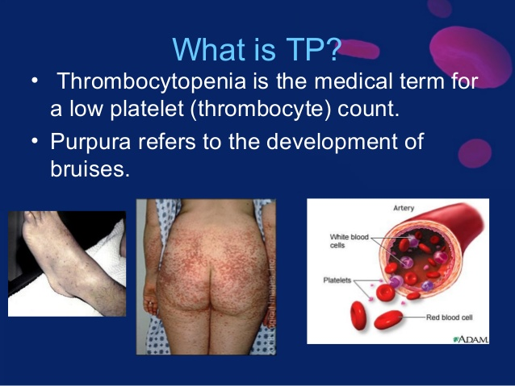
Thrombocytopenia purpura

Slide 267
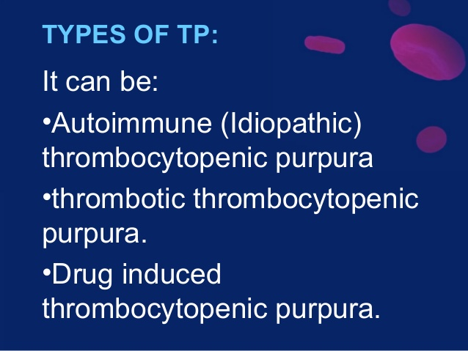

Slide 268
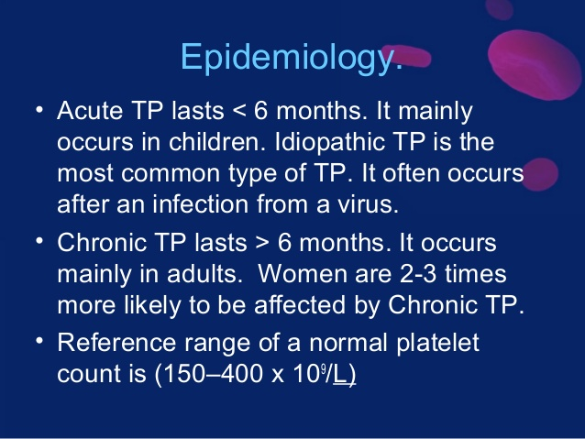

Slide 269
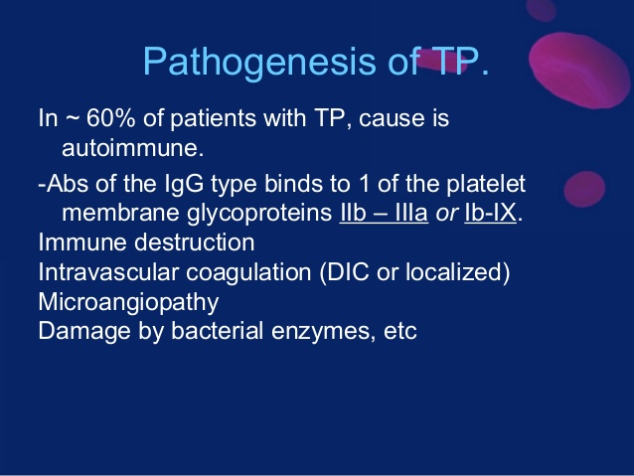

Slide 270
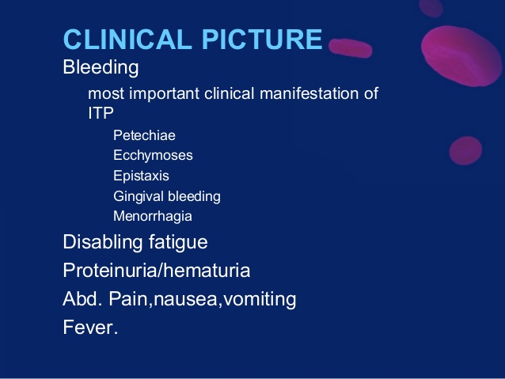

Slide 271
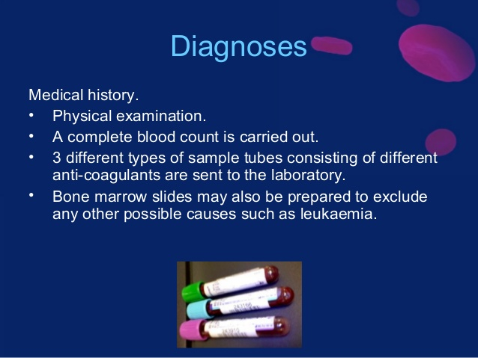

Slide 272
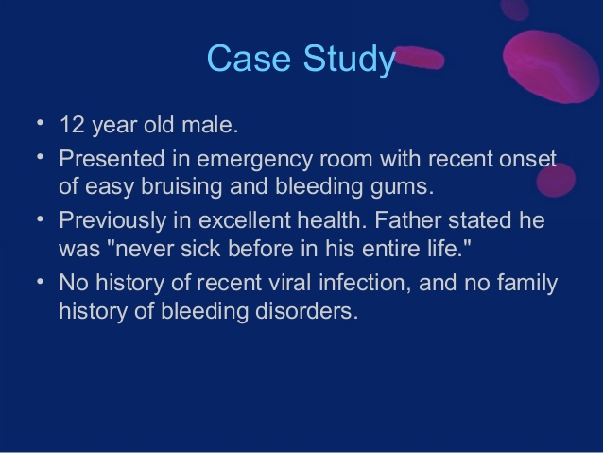

Slide 273
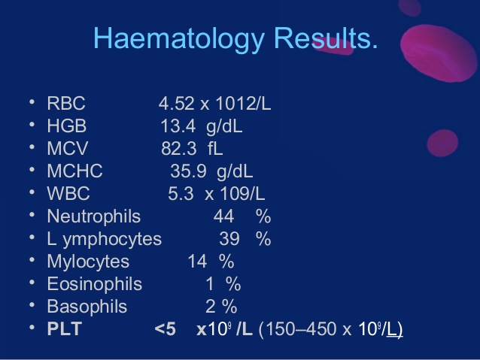

Slide 274
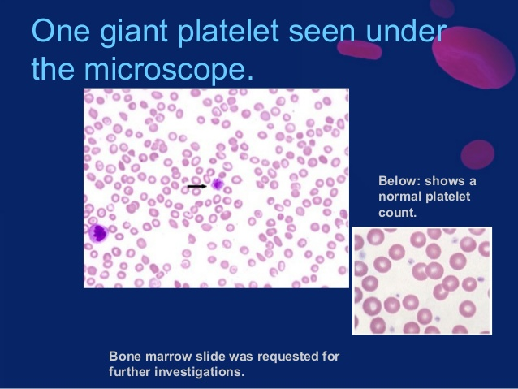

Slide 275
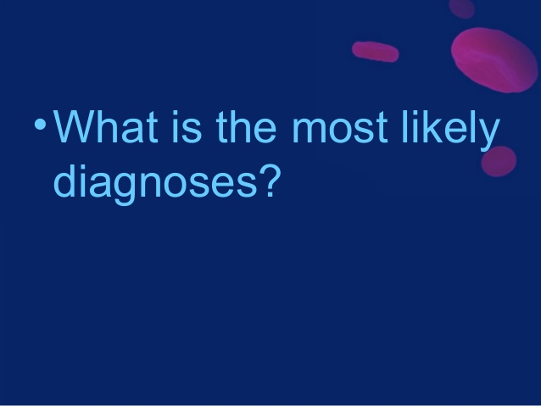

Slide 276
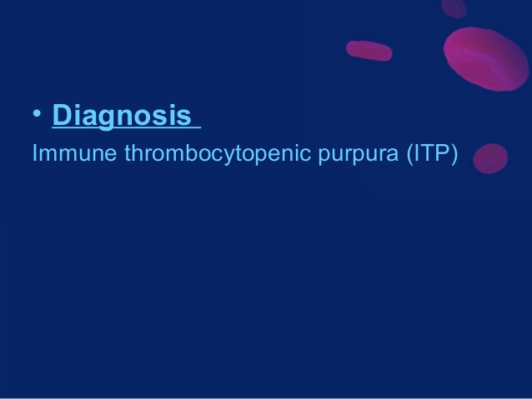

Slide 277
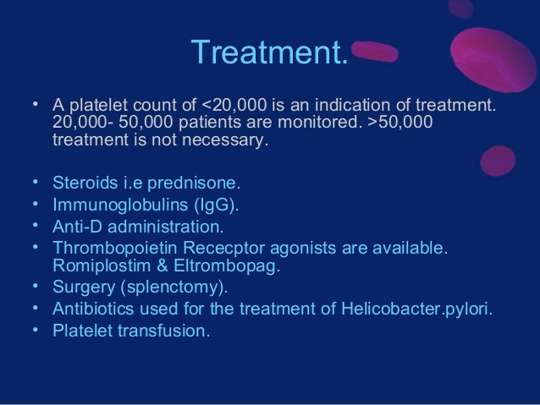

Slide 278
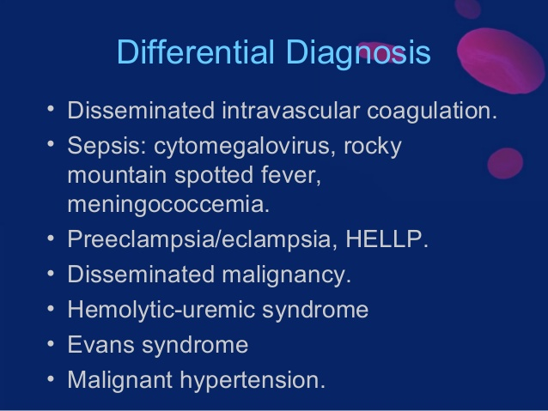

Slide 279
Thank you

